Slide 1

Analysis On Beauty Industry
Team 5: Ahjeong Yeom, Kenji Laurens, Steve Shi And Vanessa Li

Slide 2
Agenda
01
Team Introduction
03
Cloud Storage: GCP
02
Executive Summary
04
EER & Dimensional Model
Data
05
NoSQL:
MongoDB & Neo4j
03
Data Infrastructure
Data Profile
Data Quality Dimension Assessment
ETL Process
Implementation Tools
Design Considerations
Data Collection
Data Preparation
06
Five Business Use Cases
07
Lessons & Recommendations

Slide 3


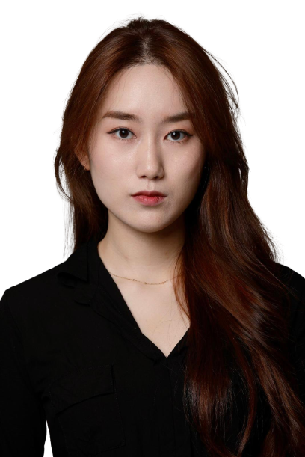

Team: Millenium Consulting
Ahjeong Yeom
Kenji Laurens
Steve Shi
Vanessa Li
KNOWLEDGE
ABILITY
Jupiter is the biggest planet of them all
Earth is also the third planet from the Sun
Founder
Data Scientist
Founder
Data Scientist
Founder
Data Scientist
Founder
Data Scientist

Slide 4
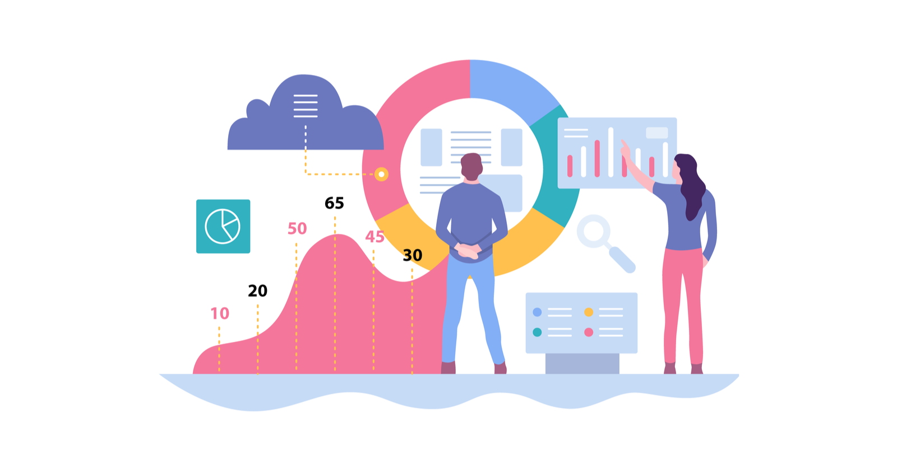
Executive Summary
Our goal is to bring more meaningful and multi-dimensional data to users on cosmetic brands and products so that both brands and end-consumers can make informed decisions
Data Collection: utilize different tools such as Tweepy API, XHR requests to extract product, twitter, brands, reviews and ingredient data from various sources
Data Cleaning: utilize Python and OpenRefine to clean data and make them ready to import into MySQL
Data Storage: database is stored in cloud (GCP) to allow multiple remote collaborators and MySQL Workbench was chosen as GUI tool
Data Model: EER and dimensional model created
Data Analysis: utilize SQL, Pandas, NLP libraries to perform analysis
Data Visualization On 5 Business Use Cases：
Brand Perception Based On Sentiment Of Tweets
Key Performance
User Journey On Demo App Built On Tkinter
Competitor Lookup
Customer Demographic and Attribute Distribution

Slide 5
Data Infrastructure
Portal
Visualization and analytic tools: Tableau, Plotly, Neo4j, Pandas, Tkinter
Strategic Data Marts
Brands, Product Reviews, Ingredients, Performance
Data Warehouse
MySQL, GCP, MongoDB, Neo4j
Data Lake
Google Drive

Slide 6
Data Profile
 | SOURCE | DESCRIPTION | DATA SIZE | FORMAT
Product | Kaggle | Products listed on Sephora | 12.4MB | csv
Brands | Phantom Buster | Information on cosmetic brands and company information | 226KB | json/csv
Reviews | BazaarVoice API | User product reviews on Sephora | 500MB | json
Twitter | Tweepy API | Users’ tweets with hashtag of brand name | 7.3MB | csv
Ingredient | California Safe Cosmetics Program Product DB | Chemicals used in cosmetics that are known to be harmful | 2.2MB | csv

Slide 7
Data Quality Dimensions Assessment
Completeness | Accuracy | Consistency | Validity | Uniqueness | Integrity
Original data did not contain all products up to this year and tweets data was limited to recent data | Tweet data contained inaccurate feedback on brands as search query was simply limited to "#brand” and not advanced keywords such as product names | The amount of data for product, reviews and tweets per brand was not consistent | For ingredient harmfulness, the data is perfectly valid as it has scientific backing. Using tweet sentiment and review data however, may not be perfectly representative of reality | A customer may have repeated review based on multiple experience Sentiment analysis may be based on multiple tweets that could have been one | Entity, domain and referential integrities were considered with constraints

Slide 8



















ETL Process: Extraction, Transformation & Load
Data Sources
Extraction
Transformation
Load

Slide 9



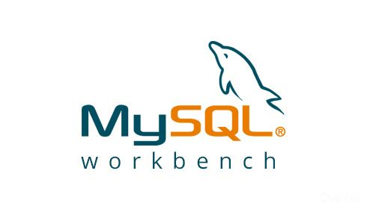

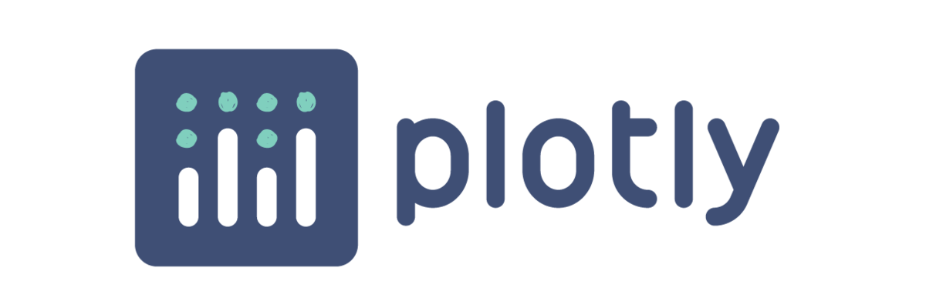



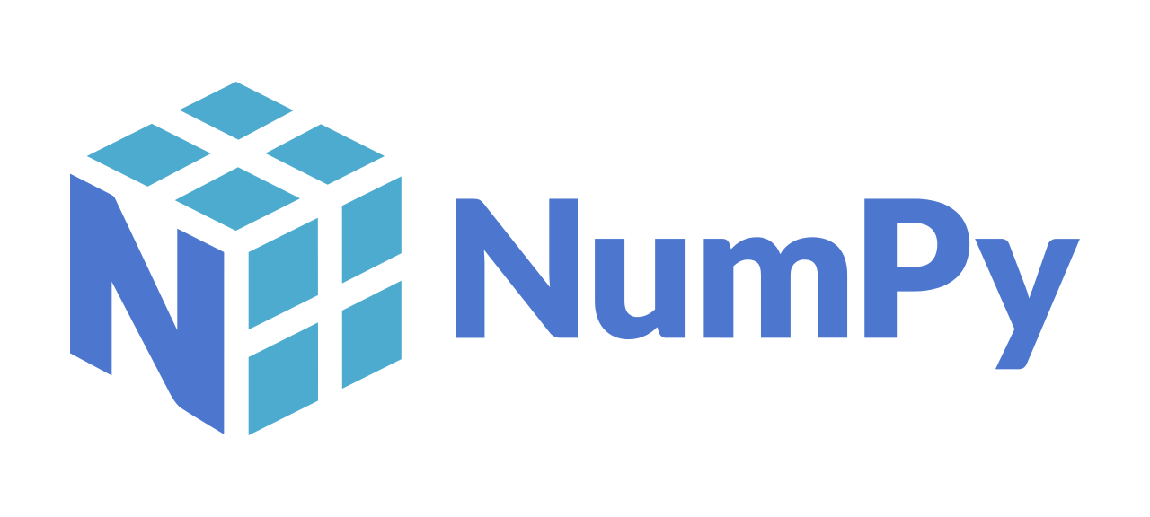
Implementation Tools
Data Processing/Storage
Visualization
Python: Data Cleaning and Processing
MySQL(GCP, SQLWorkbench): Data storage and model design
NoSQL(MongoDB) Data Storage
OpenRefine: Data Cleaning and Processing
Tableau
Python
plotly
Neo4J: Graph visualization
Data Collection
Analytics
Application
Python: Beautifulsoup, Tweepy
Phantom Buster
Bazaarvoice API
Selenium
Python: pandas, numpy, nltk, textblob
Python: tkinter

Slide 10
Design Considerations
Product Reviews
Branding
Original product contains products across all categories, but we limit our data to facial brands under Sephora’s makeup and skincare categories
The reviews have too many attributes that are sparsely populated due to the difference between product categories, making it hard to create table columns in SQL for it
Thus, using NoSQL and store as key value pairs is what we decided to do
Outliers & Anomalies
Tweet location data contains non-location data
Intensive clustering and replacing with NULL if no-location can be derived from
Data Naming Convention
Standardize the format for names across entities and attributes (snake case)
Ingredients
Intermediary lookup table linking harmful ingredients to the product’ ingredient
Normalization
Using brand id across the tables, referring to the brand table to normalize
Dealing With NAs
MySQL Workbench recognizes NULL instead of empty string so removed unused columns and filled NaNs as NULL

Slide 11

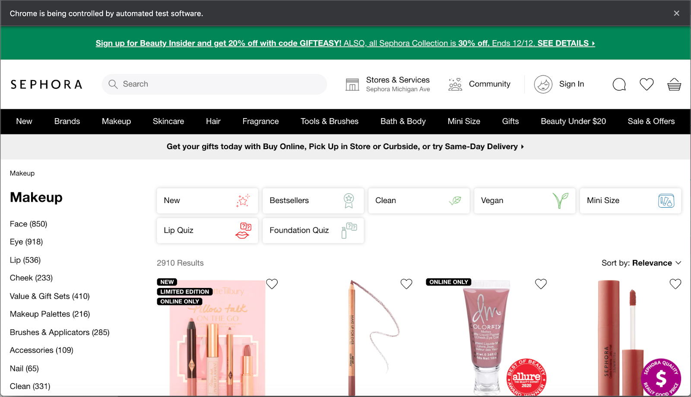
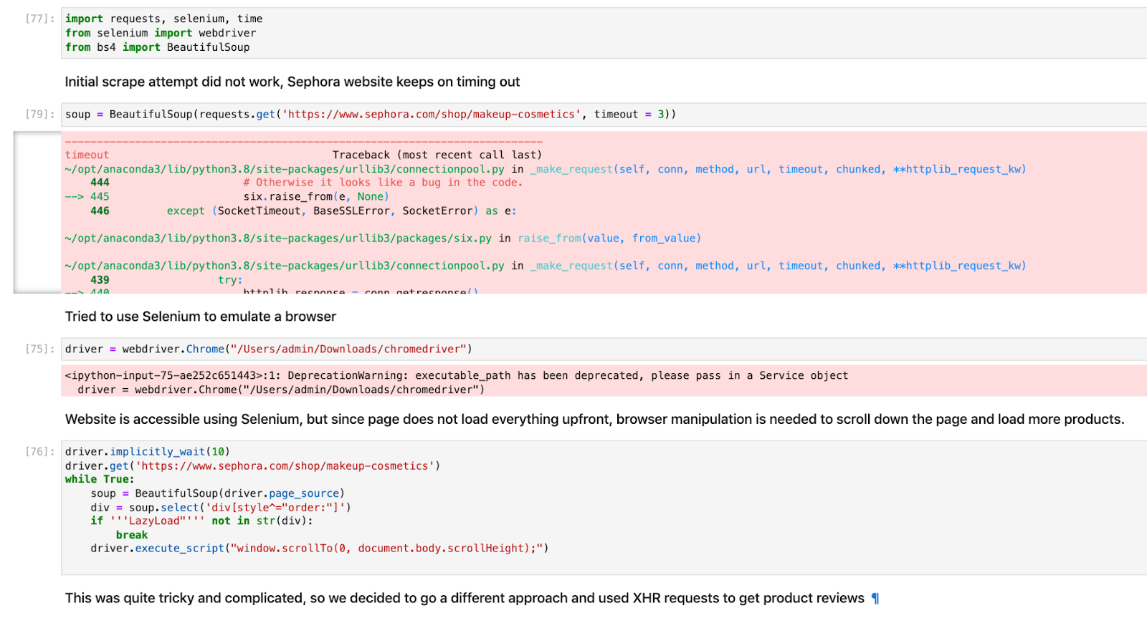
Data Collection: Selenium Attempt
Selenium was considered initially as a substitute to BS4 to scrape Sephora
Due to JavaScript components on Sephora, BS4 was not able to properly parse the page
Used Selenium to emulate a browser and execute JavaScript
Problems arose due to delayed page execution

Slide 12
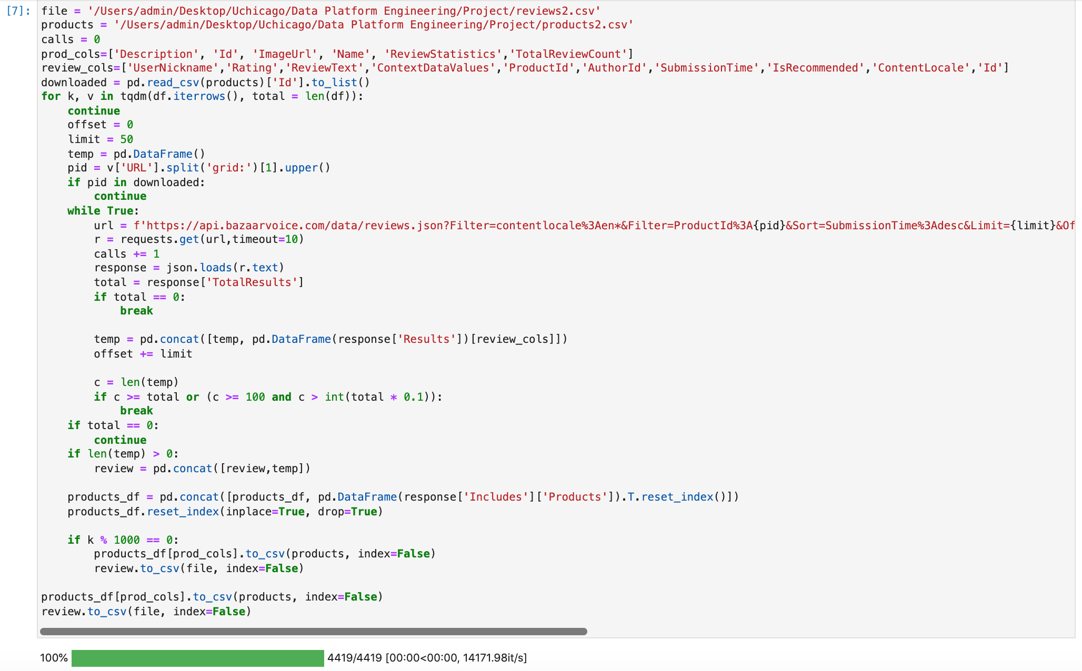
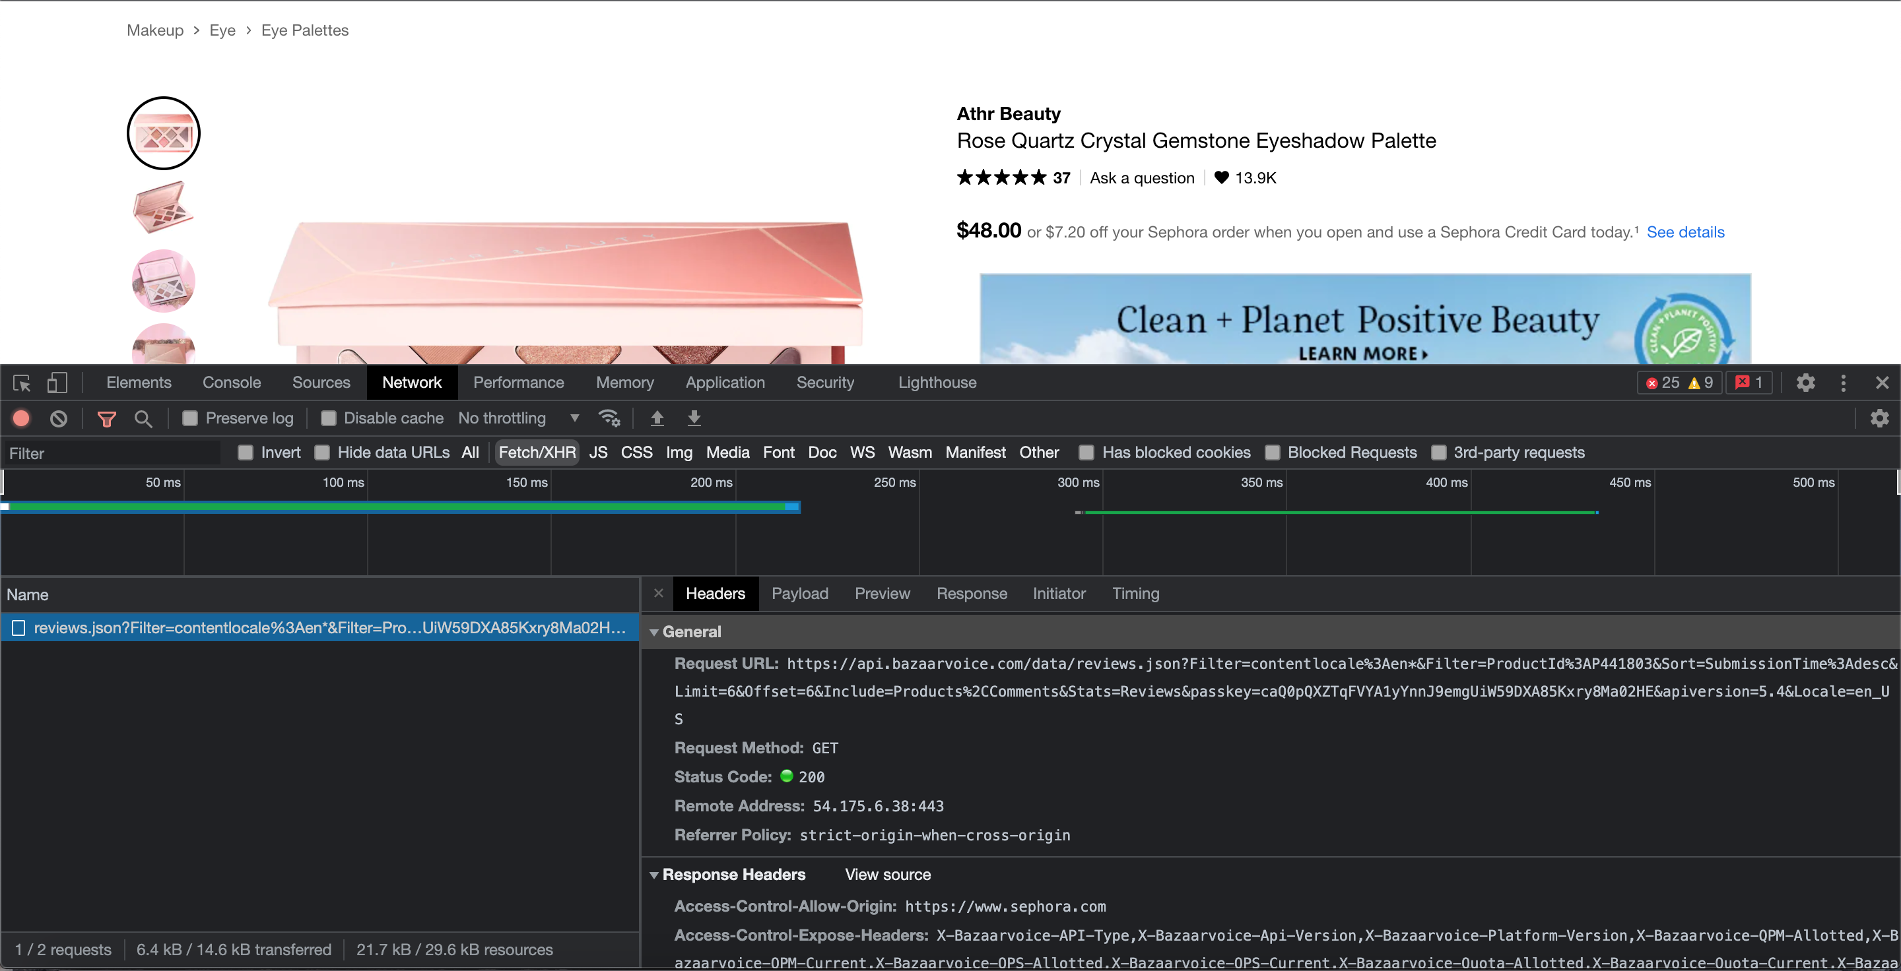
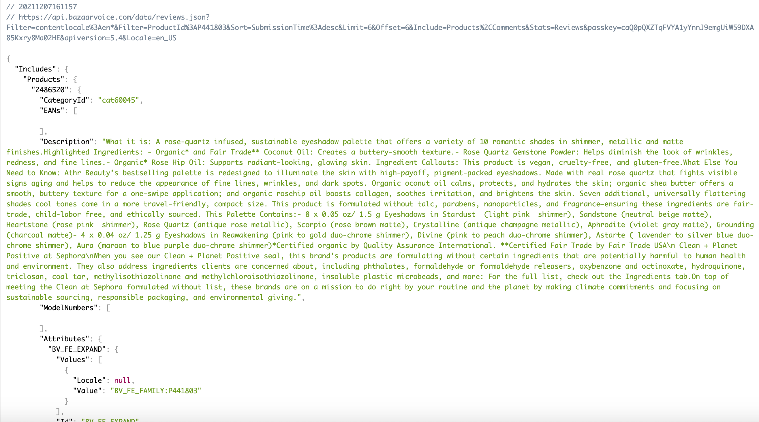
Data Collection: XHR Requests To Scrape Sephora Data
XHR provided a better solution to scrape Sephora product reviews over BS4 & Selenium
Since scraping with both BS4 and Selenium did not work, we turned to XHR requests
This turned to our advantage since the XHR API was generally cleaner, more complete product listing (website removed old products) and contains reviewer metadata

Slide 13
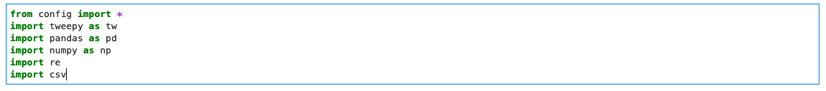
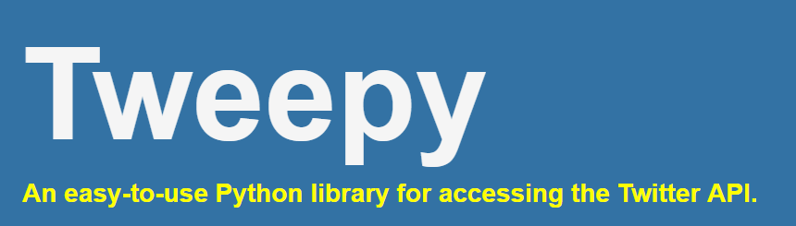
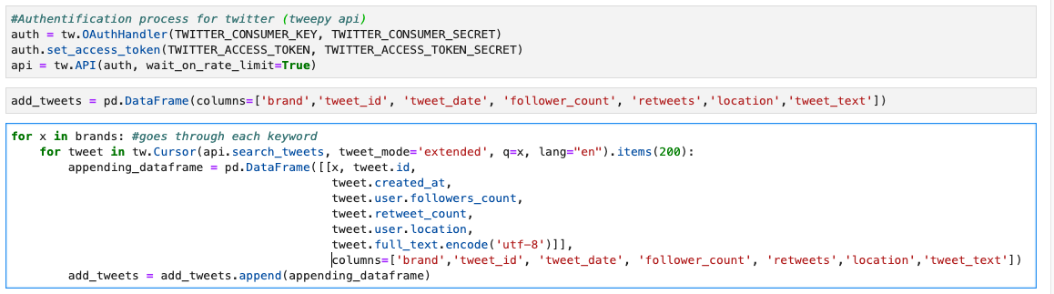
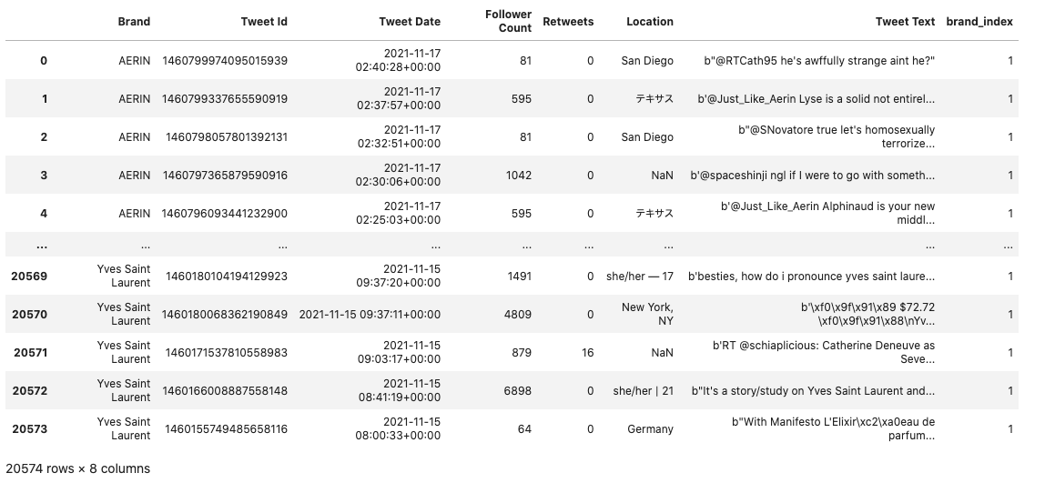
Data Collection: Tweepy Api
Tweepy Api helped collect tweets with brand name hashtag (ie. #AERIN)
Tweeter developer account created to use the free-tier api calls to scrape tweet data per brand (brand, tweet_id, tweet_date, follower_count, retweets, location, tweet_text)
Iterate over brand names in brands table and append collected tweets to dataframe using Pandas
For 186 brands, avg 110 tweets per brand were collected but number of tweets varied per brand, which could result in diminishing the value of analysis

Slide 14
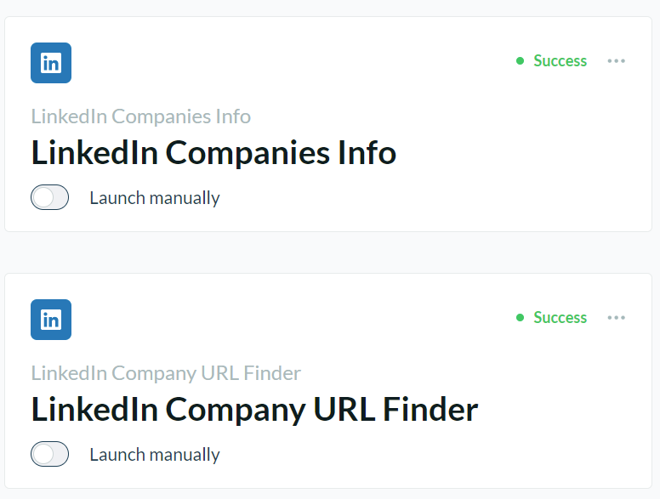
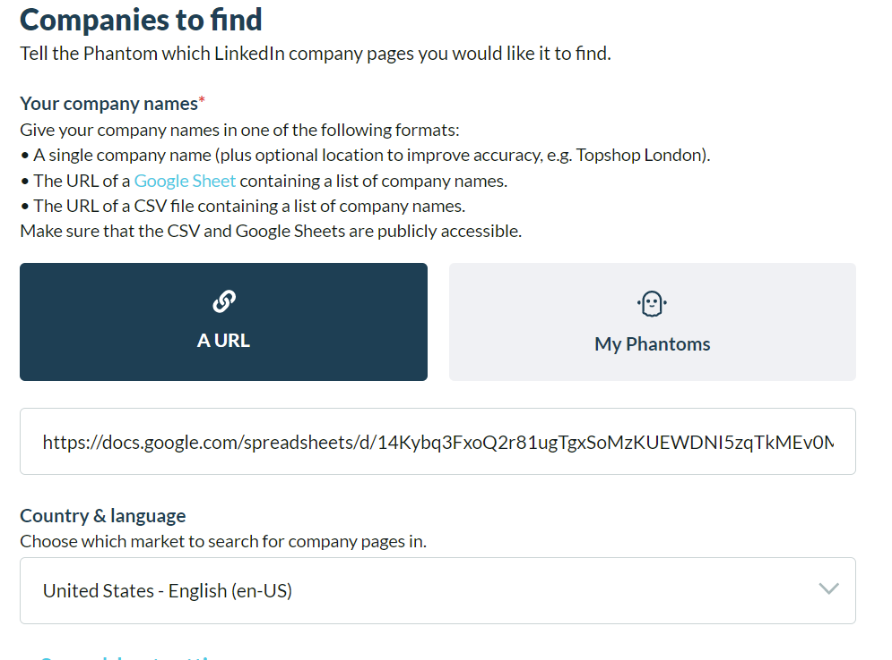
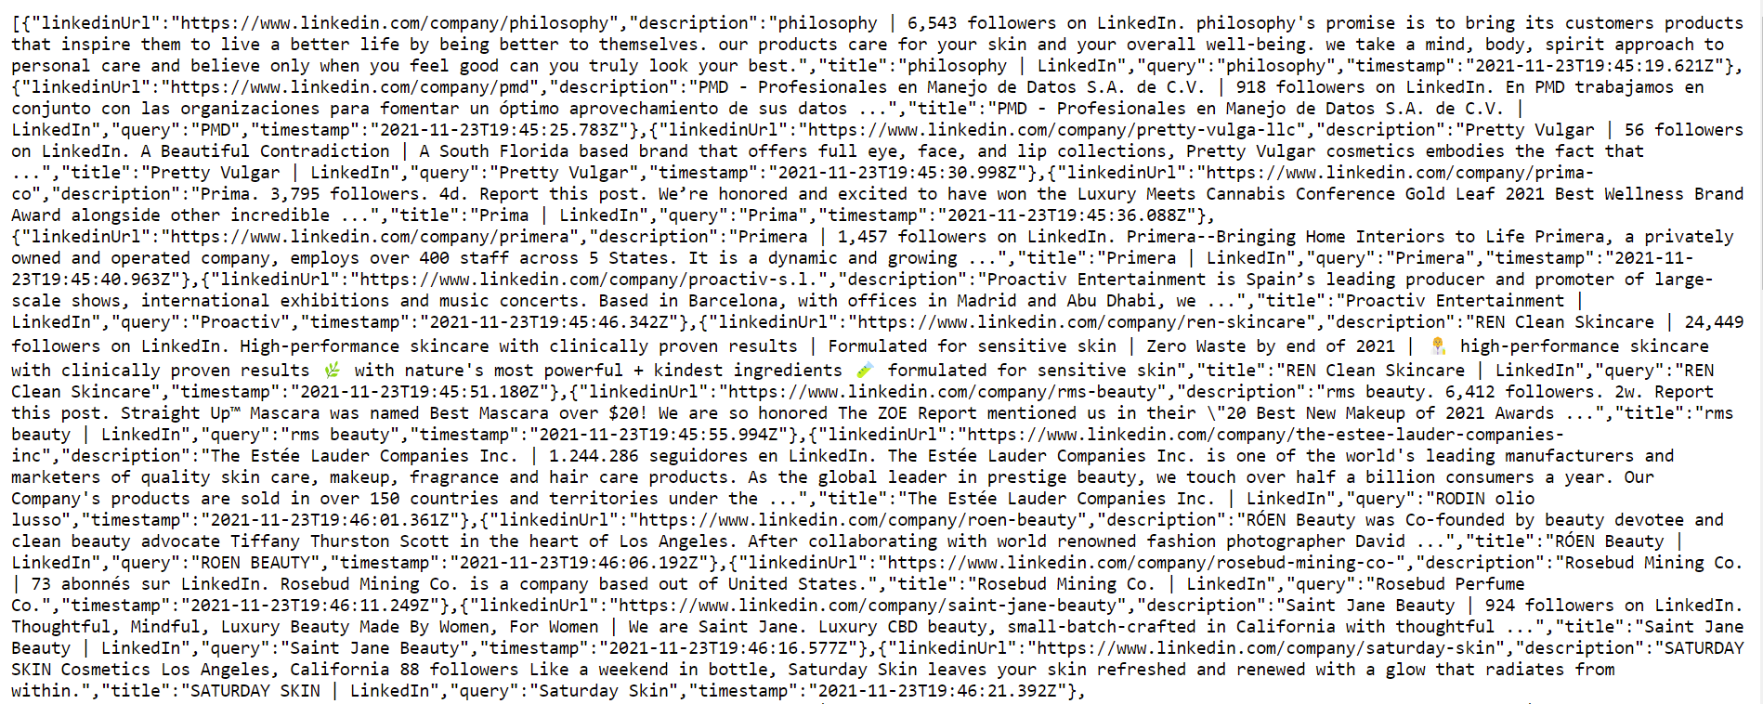

Data Collection: Phantom Buster
Phantom Buster Was A
Great Substitute to BS4 To Scrape Brand Data
Attempted to scrape data from Wikipedia, but not all brands are listed on Wikipedia
Discovered most brands have their company page on LinkedIn providing valuable information
Chose Phantom Buster to extract brand information automatically from LinkedIn
The extraction result is in JSON/CSV format

Slide 15
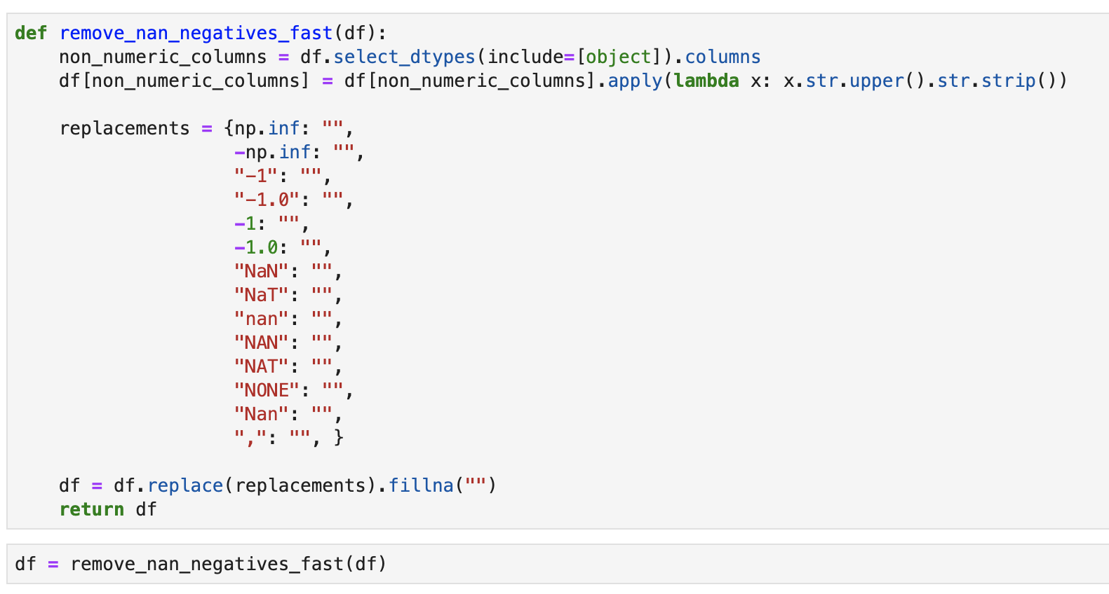
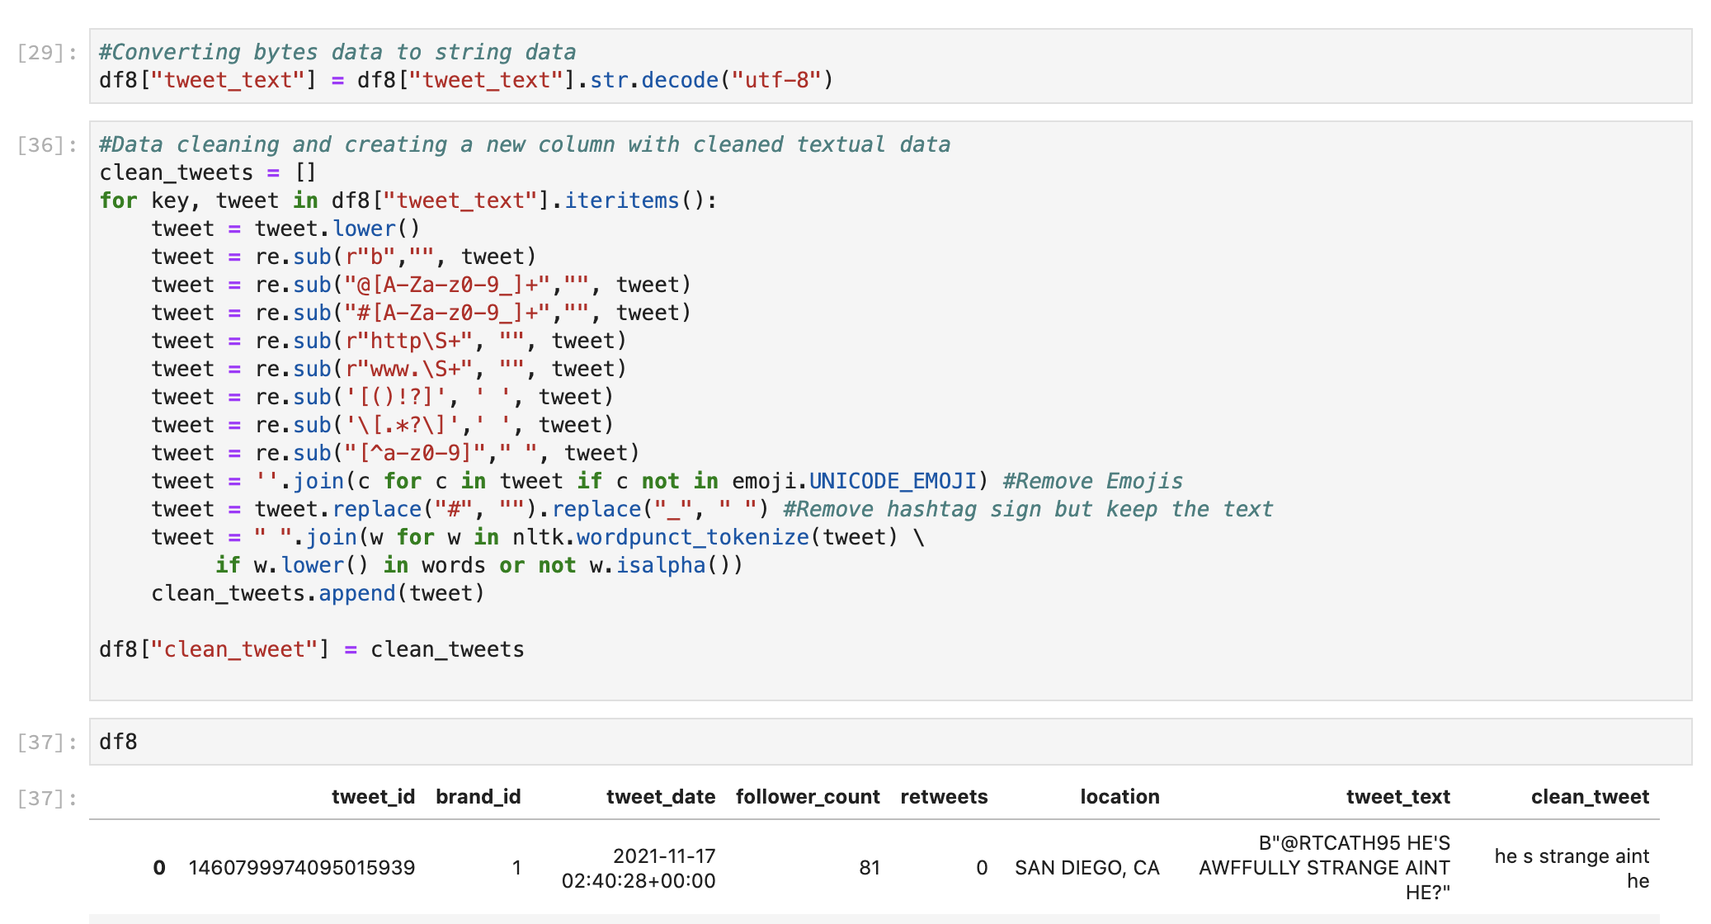
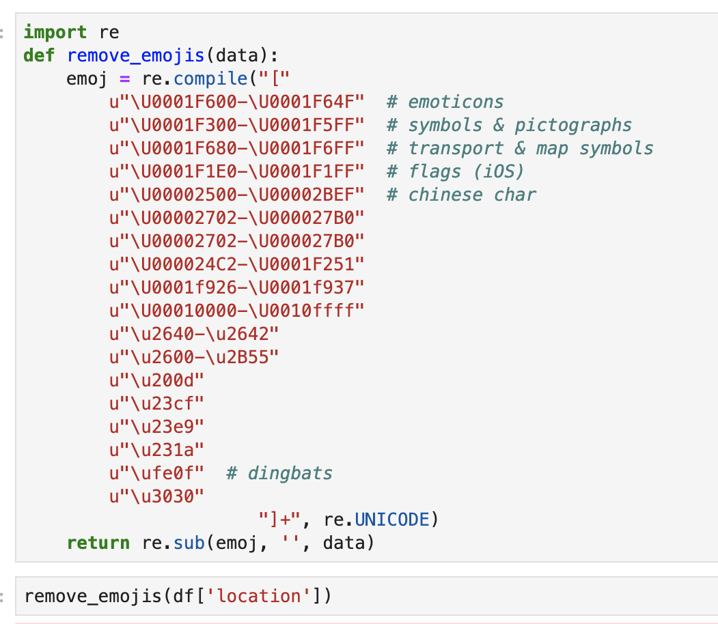
Data Preparation: Data Cleanup
Removing NaN
REGEX To Clean Tweet Text
Removing Emojis From Tweets
REGEX: Tweet text data includes emoji, hashtag, numbers, links and etc so REGEX is used to clean up each text
NLTK: NLTK tokenizing by word was used to extract more meaningful and logical words from cleaned tweet texts

Slide 16
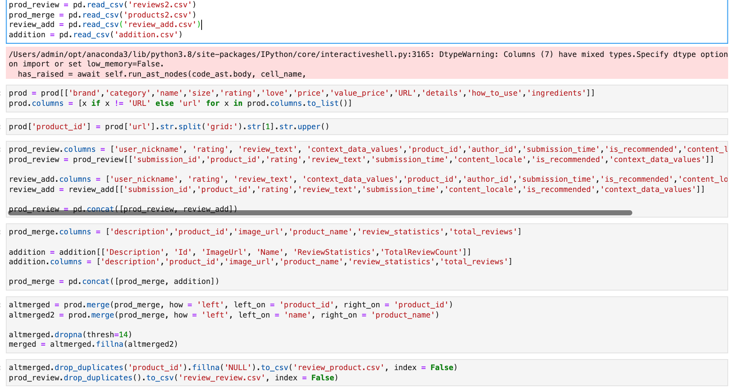
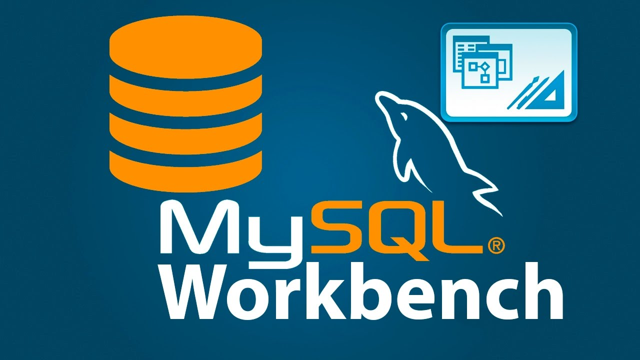
Data Preparation: Data Cleanup Continued
Data Preparation For MySQL Workbench Import
Removing unused columns and filling NaNs as NULL – MySQL Workbench recognizes NULL instead of empty string

Slide 17
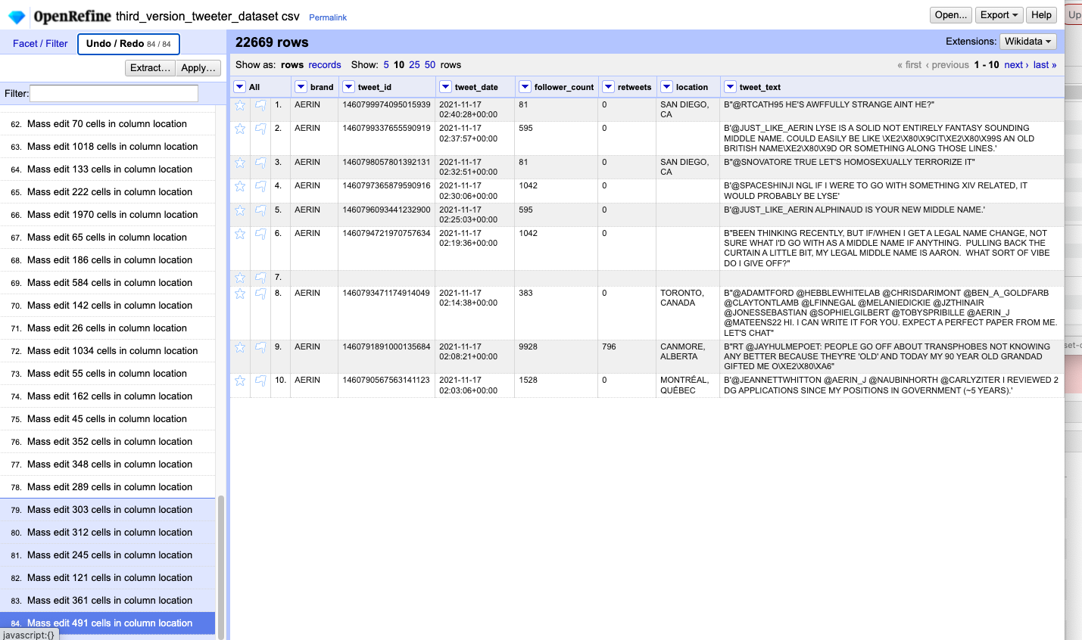
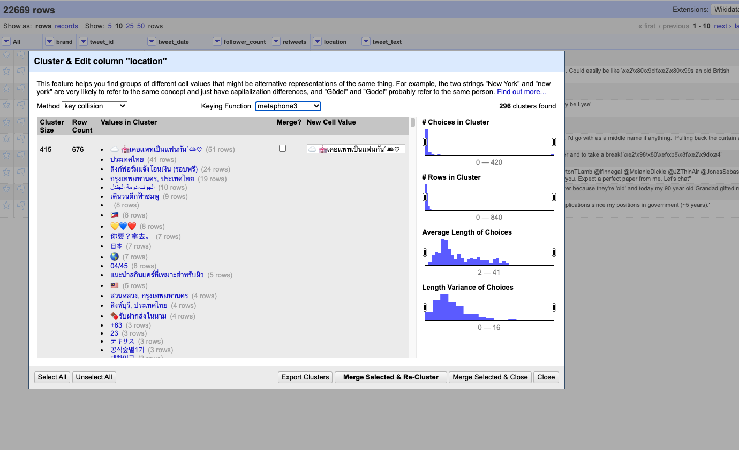
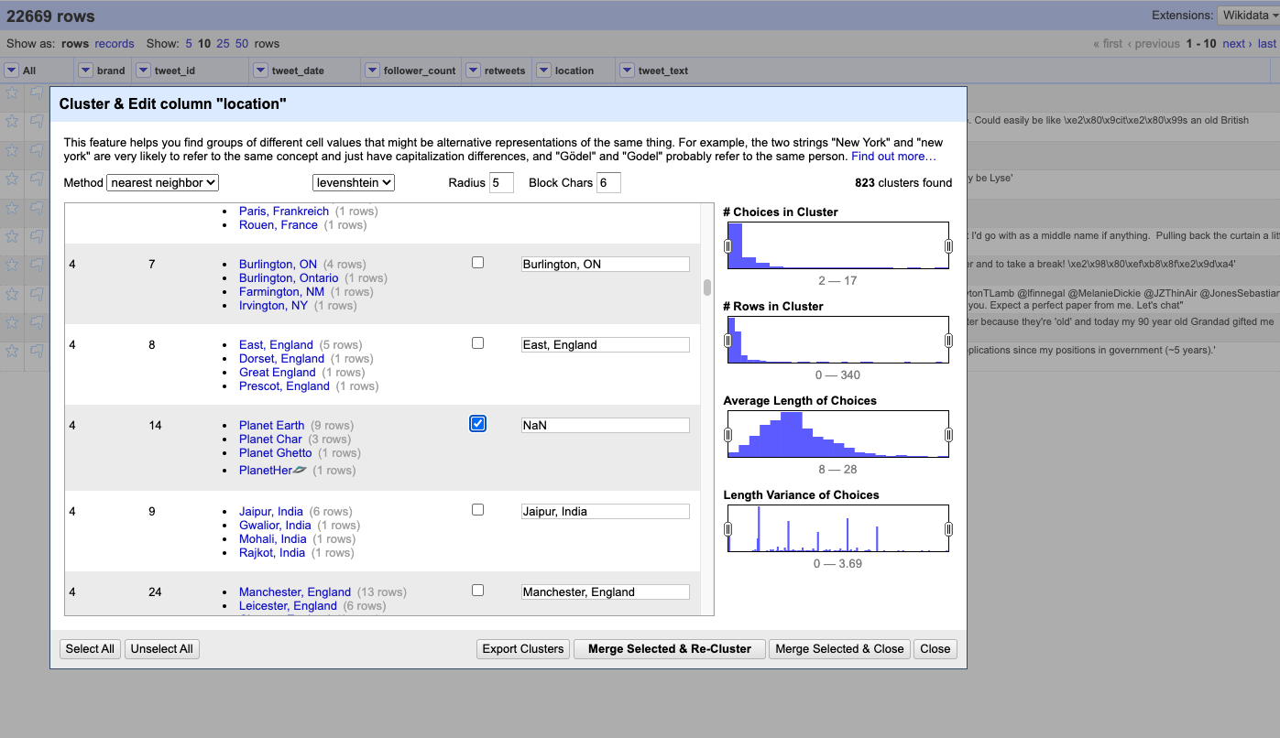
Data Preparation: OpenRefine
Clustering On Location Data From Tweets
Tweets’ location is not structured so cleaning up the users’ various input on location required heavy clustering that involved:
Key Collision Methods
Nearest Neighbor Methods
Fingerprinting
N-Gram Fingerprint
Phonetic Fingerprint (metaphone3 was the most effective in finding and clustering data that was not appropriate as location)
For data that was not classified as location, “ ” was assigned.

Slide 18
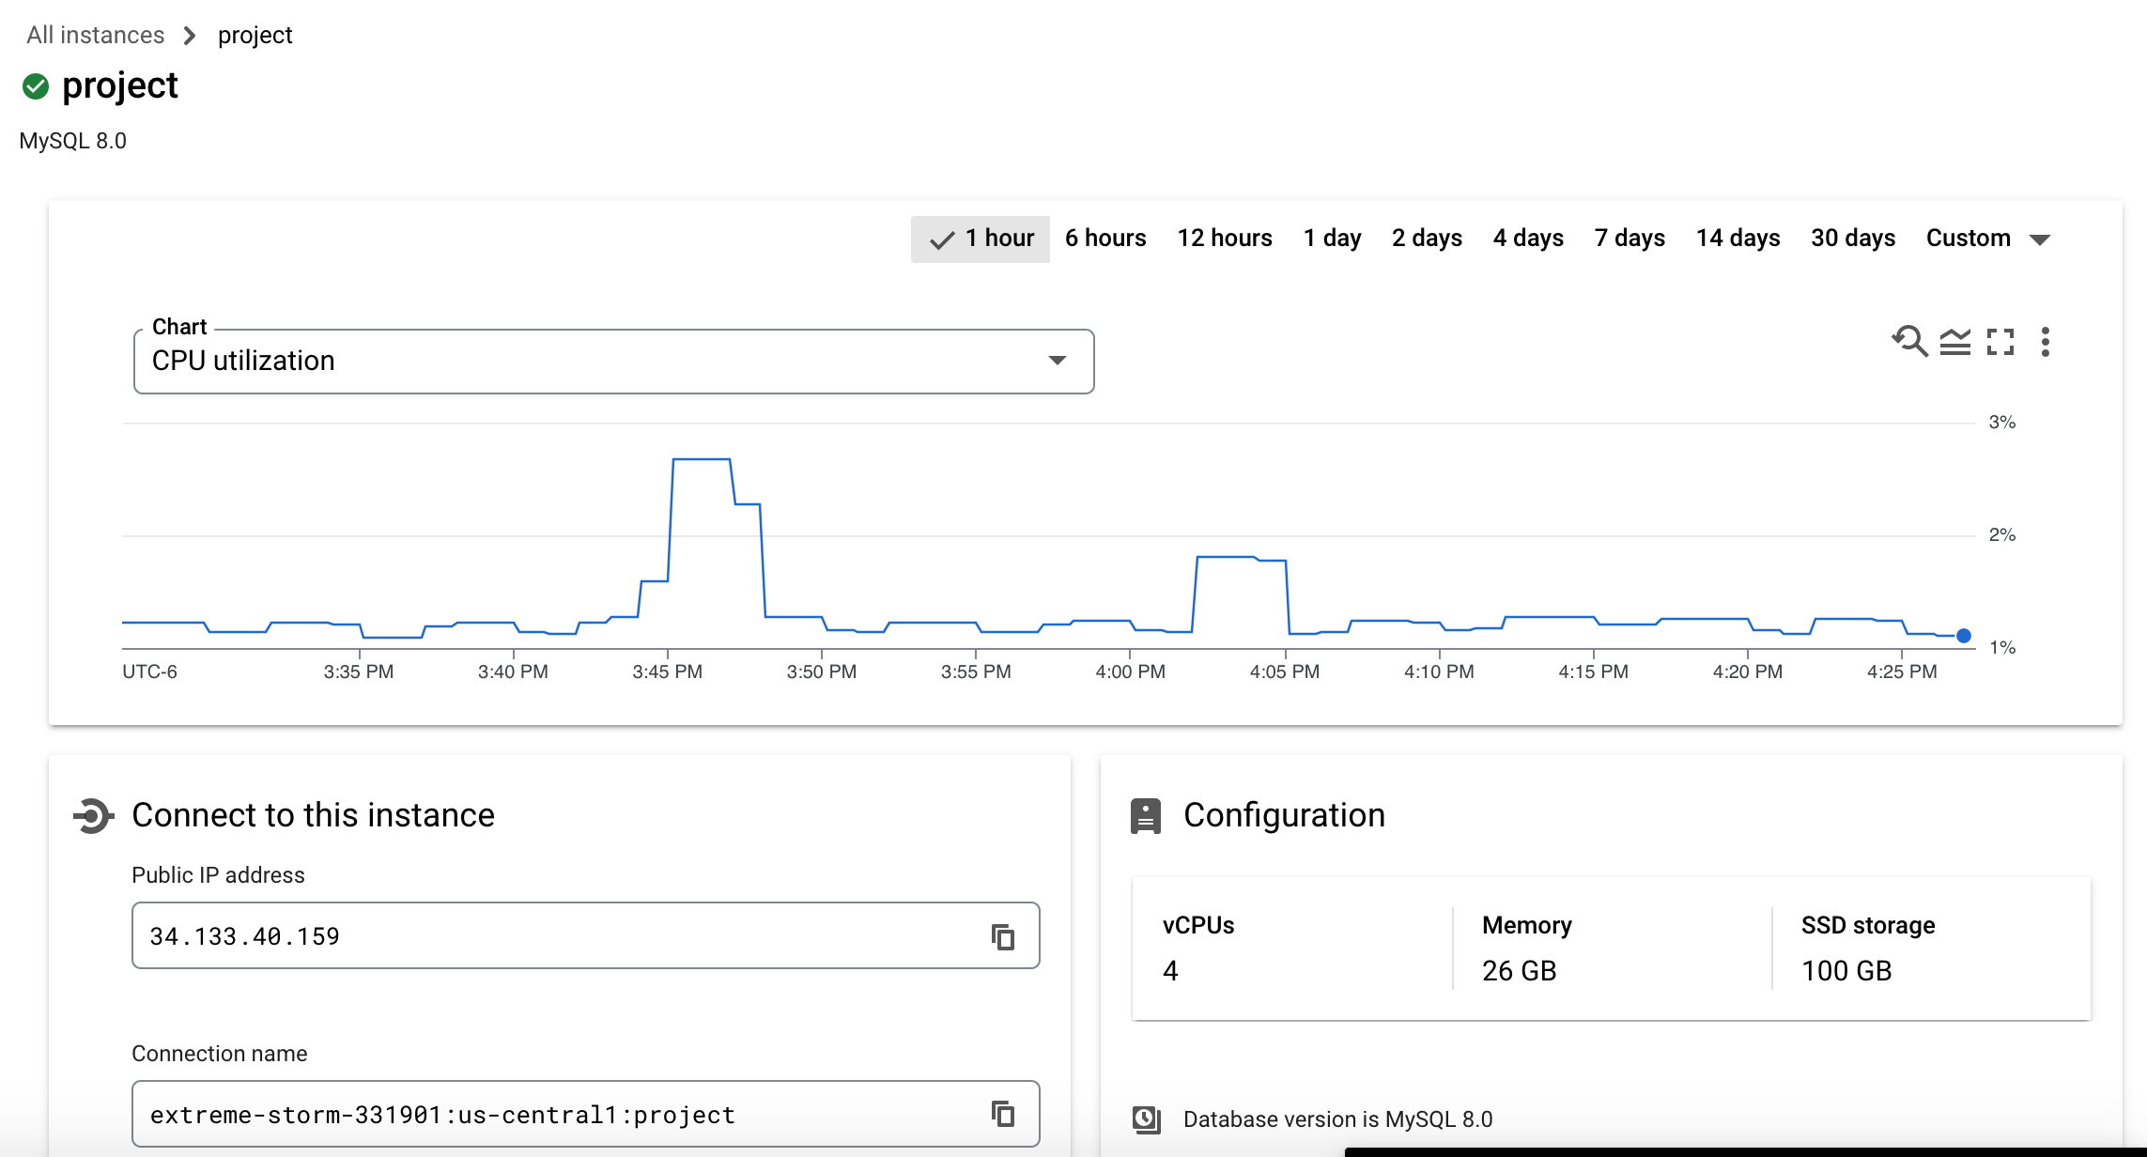
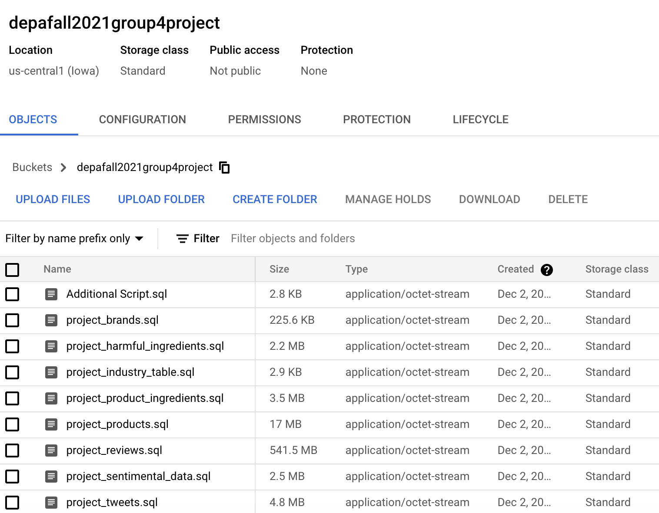
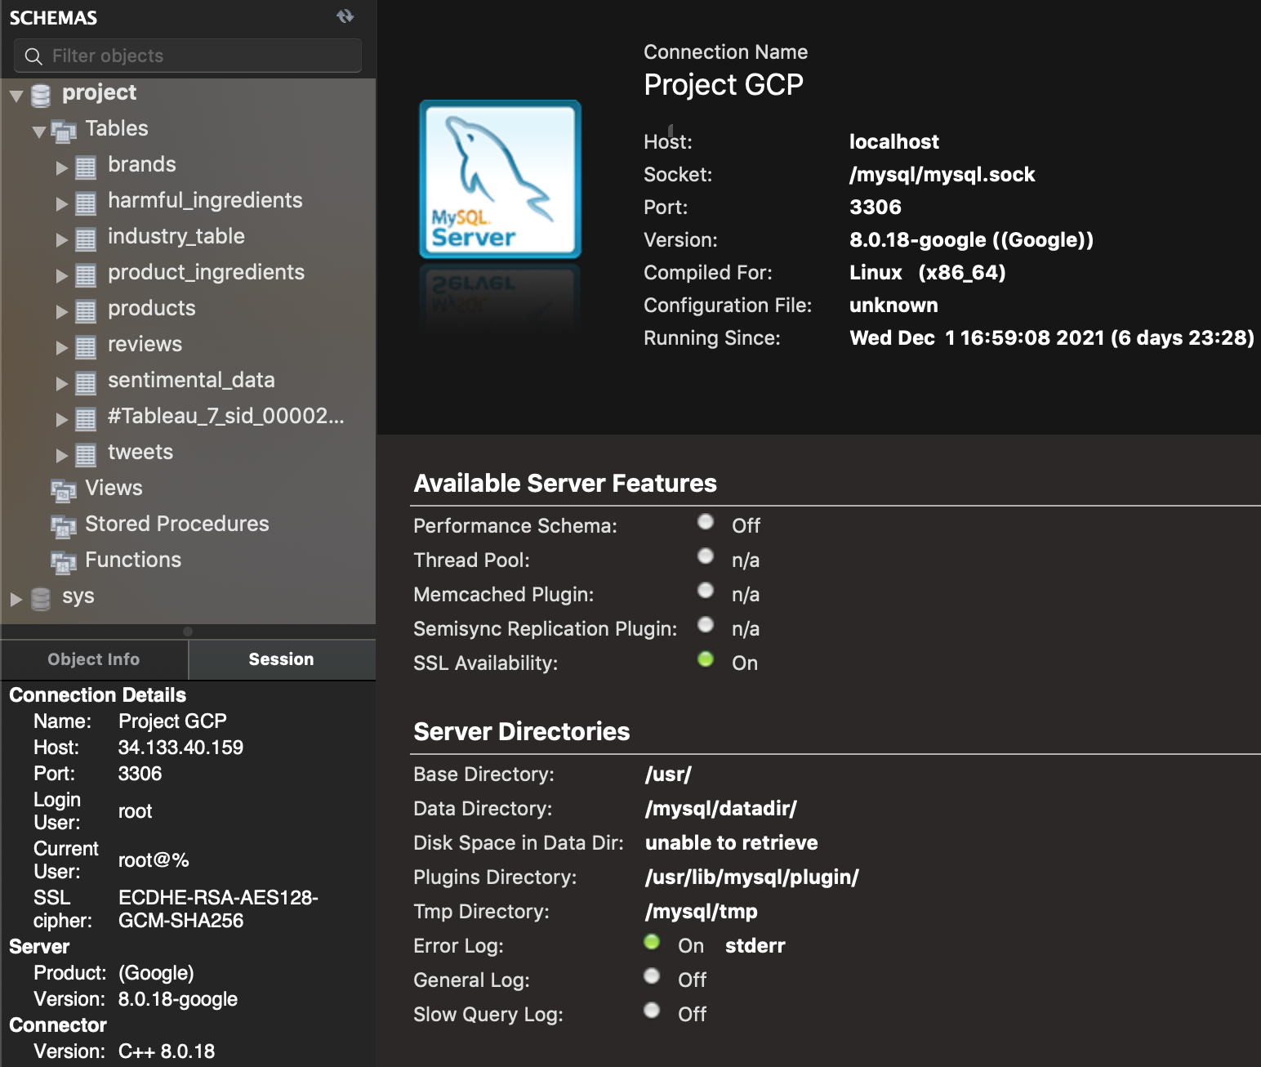
Cloud Data Storage: GCP
MySQL Instance on GCP
To allow multiple remote collaborators, database is stored in the cloud, as provided by Google Cloud Platform
Raw Data is stored on GCP bucket (typo on bucket name)
MySQL Workbench was chosen as GUI tool

Slide 19
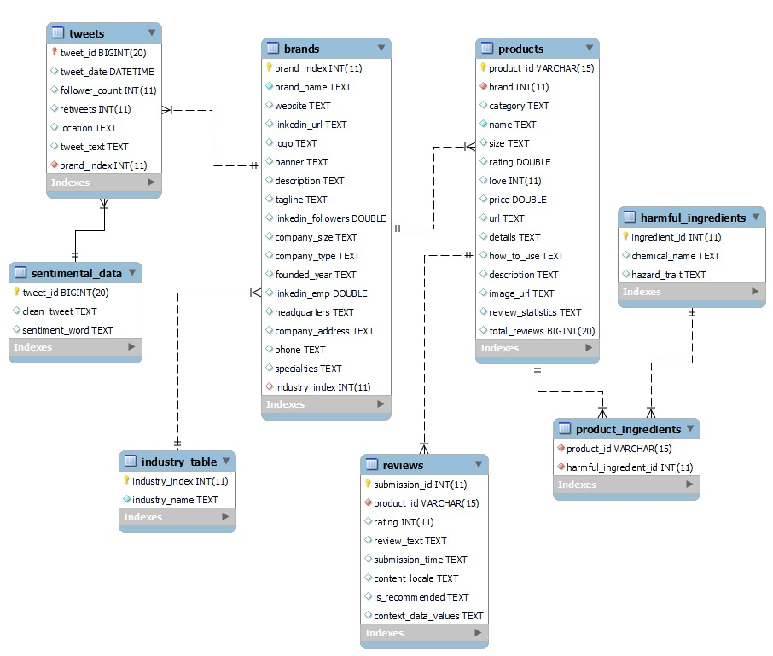
SQL: EER Model
OLTP
There are 8 tables in the database
After data collection and processing, import our data into MySQL Workbench and perform reverse enginnering to create the schema
Define attributes with approriate data type
Follow standard naming convention for tables and attributes
Each table contains its unique key as primary key

Slide 20
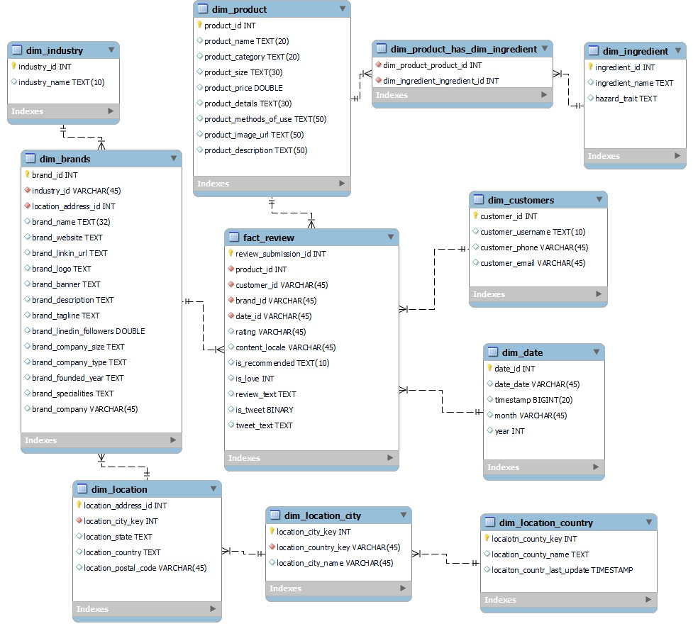
SQL: Dimensional Model
OLAP
Dimensional Model was developed based on the EER model constructed
Used Snowflake Schema and normalized some dimension tables such as location table and product table
“Reviews” is the fact table and there are 4 entities: customers, brands, product and date
An extra entity, “dim_customers”, exists in dimensional diagram. Original data source included customer data such as customer username and personal info, but due to data privacy concerns, we decided not to include customer data in our project database

Slide 21
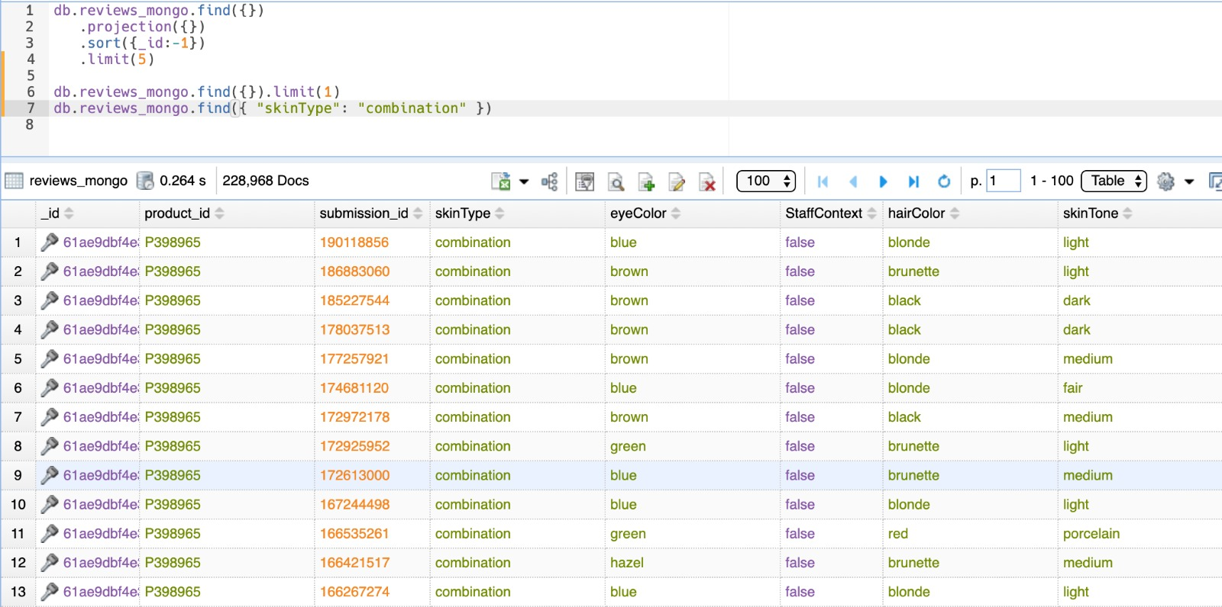
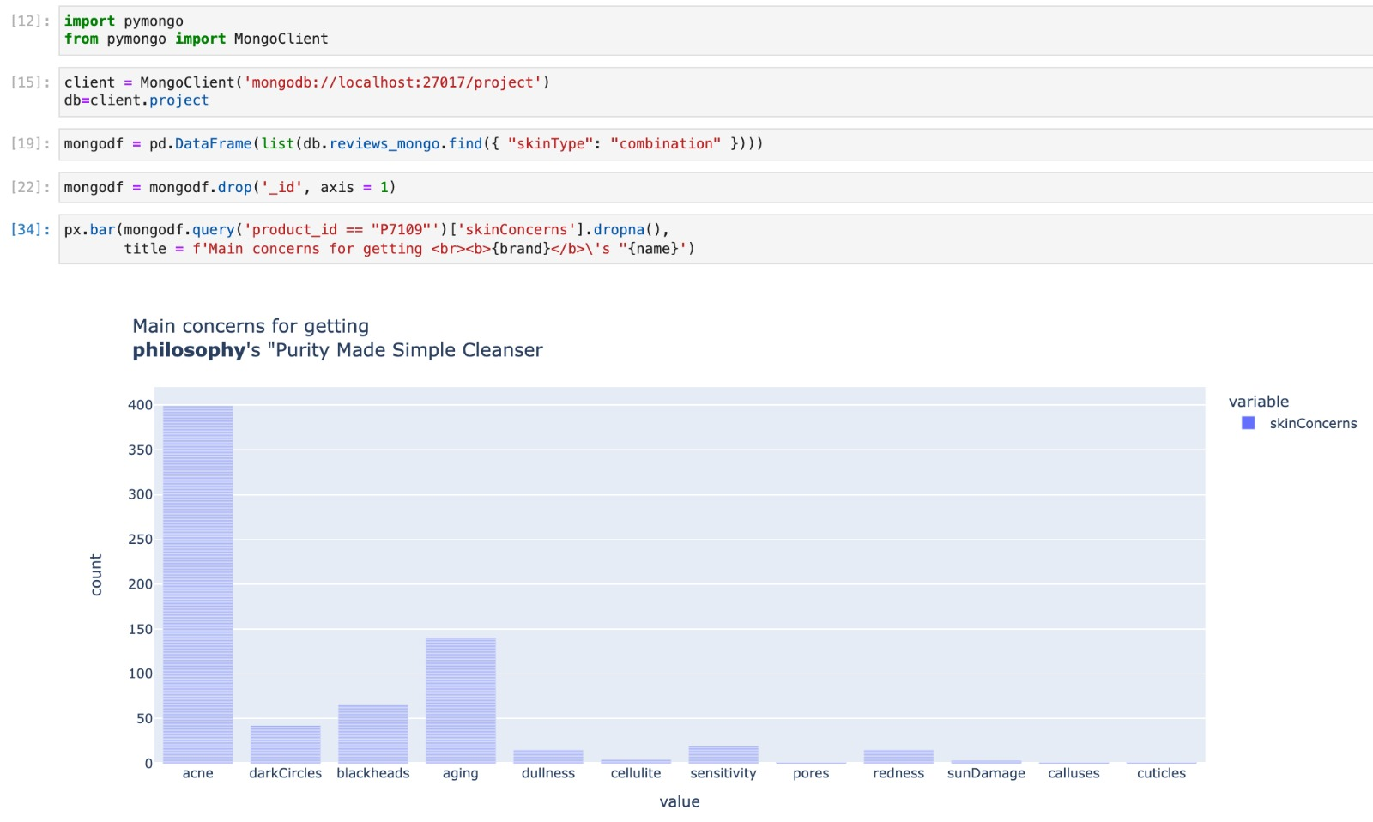
NoSQL: MongoDB – Reviews Customer Context
Review Context & Metadata Stored
MongoDB is used to store review context data
This includes metadata on customer attributes such as their eye color, skin tone, if they are employees, etc
Nested data fit for document data type
MongoDB is chosen because of their non-relational nature and compatibility with nested JSON
Different products may have different attributes that may not make sense if put on other product categories. For example, skin type for lipstick

Slide 22
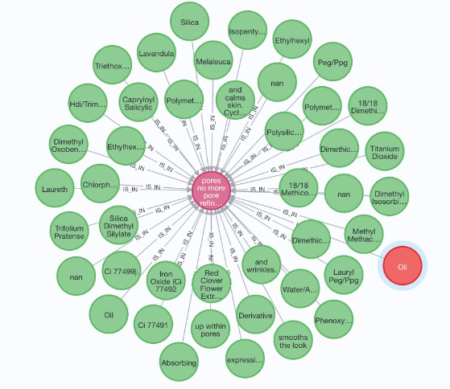
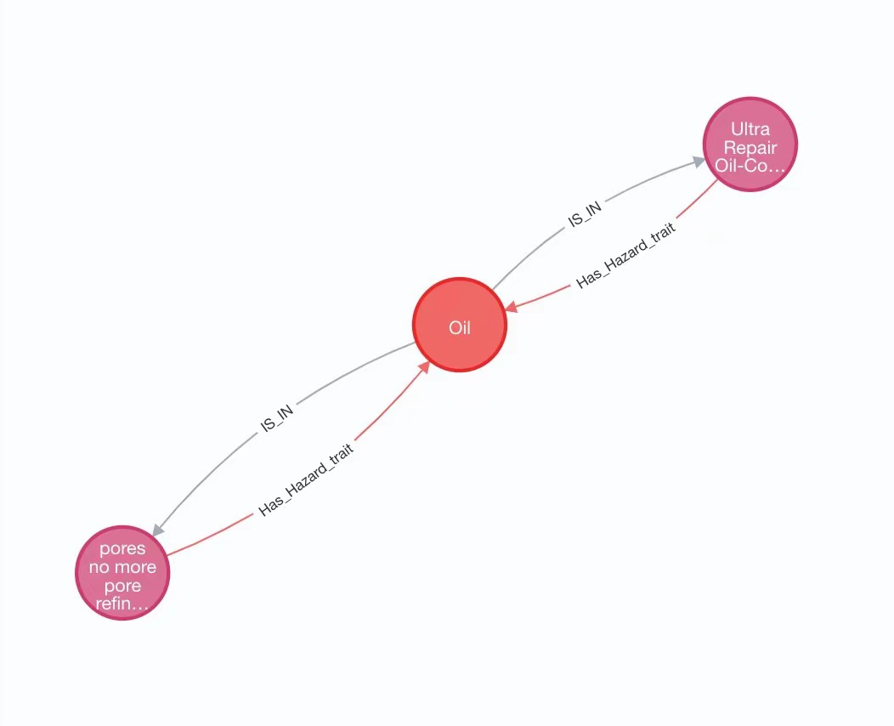
NoSQL: Neo4J - Product Ingredient Relationships In Graph
Neo4j
Shows all the ingredients contained in the product
If the ingredient has hazard traits, the node of this ingredient will be red.
Choose an ingredient （or hazard ingredient) and we can see the products that contain it
GRAPH1
GRAPH2
(a:Ingredient)-[:IS_IN]->(b:PRODUCT)
(p:PRODUCT)-[:Has_Hazard_trait]->(h:Hazard_Ingredient)

Slide 23
Five Business Use Cases With Analyses
1
2
3
4
5
Branding
Key Performance
Ingredients
Competitor Lookup
Product Reviews
Quantify brand perception in the form of textual data
Look at similar products to evaluate product performance
Suggest products without harmful ingredients
Perform a competitor analysis on brands and their product profile
Gaining insights based on user product review
Output
Output
Output
Output
Output
NLP powered sentimental analysis
Tableau dashboards at brand and product level
Neo4j graph & tkinter application
Tableau dashboard with brand logo & site rendering
Analyses using Plotly, Pandas, ggplot

Slide 24
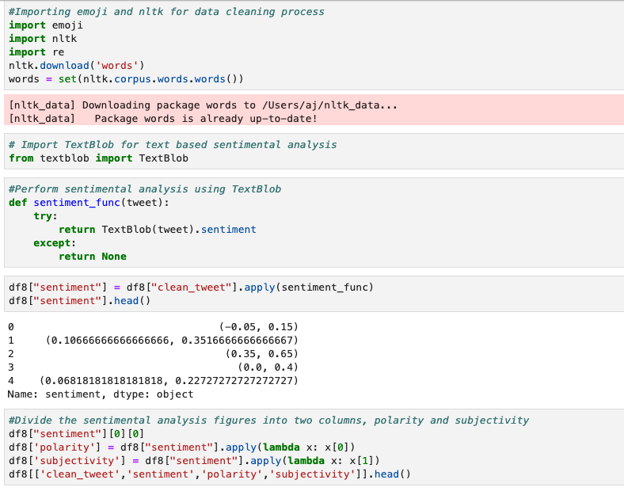
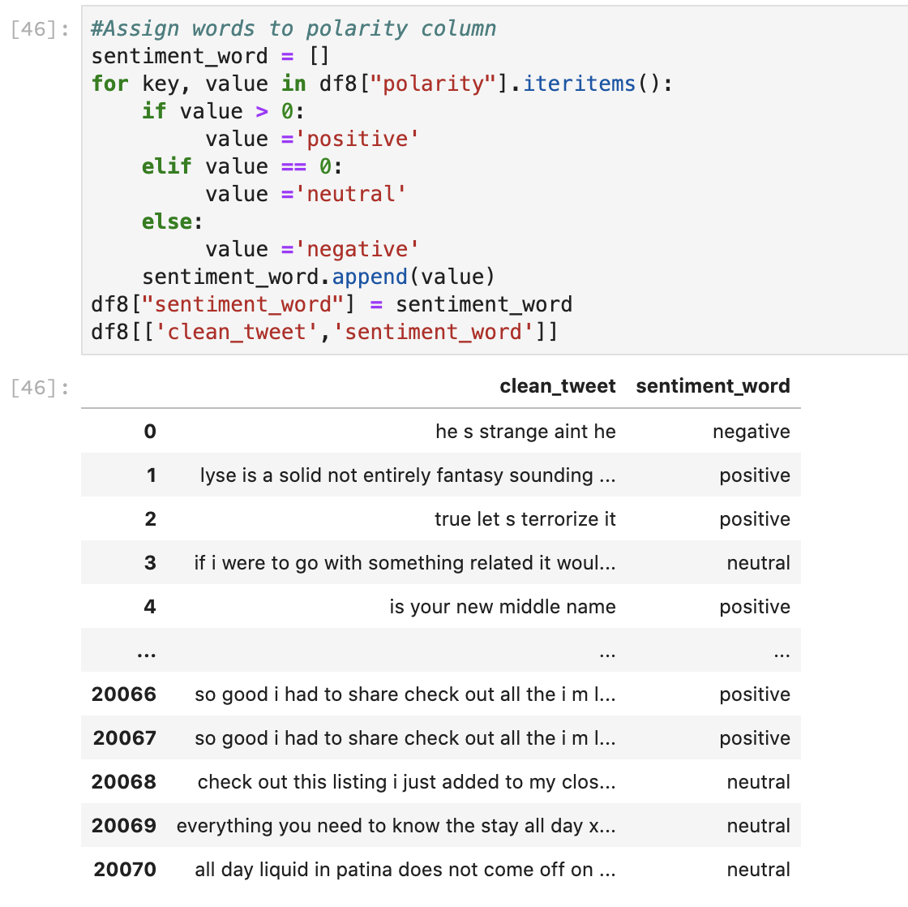
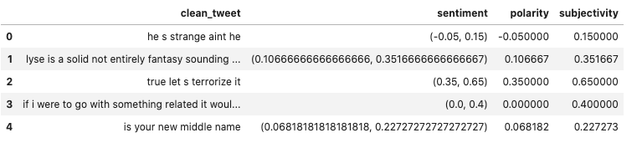
Case 1: Tweet Sentimental Analysis Using TextBlob And NLP
NLP powered tweet analysis
Sentiment analysis is the task of determining the emotional value of a given expression in natural language.
Using collected tweets data per brand, perform sentimental analysis using TextBlob
Textblob (NLP Api) sentiment analyzer returns two properties for a given input sentence:
Polarity: -1 is negative, +1 is positive sentiment
Subjectivity: Subjective sentences generally refer to personal opinion, emotion, or judgment.
Use polarity to assign word to each tweet: positive, negative and neutral

Slide 25
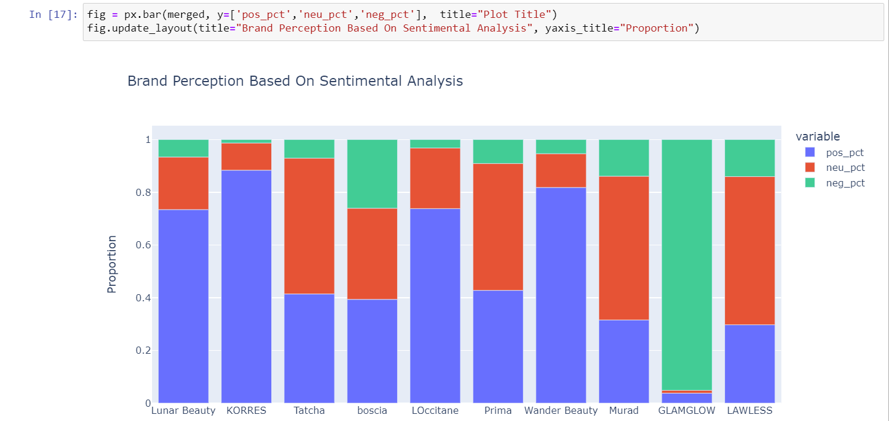
Case 1: Brand Perception Based On Sentiment Of Tweets
Clients can get insights
from sentimental analysis of
customers’ tweets
This graph shows the relative perception of brands based on tweet sentiment analysis
Again, tweets are processed through an NLP model and classified if they were either: Positive, Neutral or Negative in sentiment
For example, GLAMGLOW has received a lot of flak and bad press
KORRES on the other hand has generated a lot of positive buzz on Twitter

Slide 26
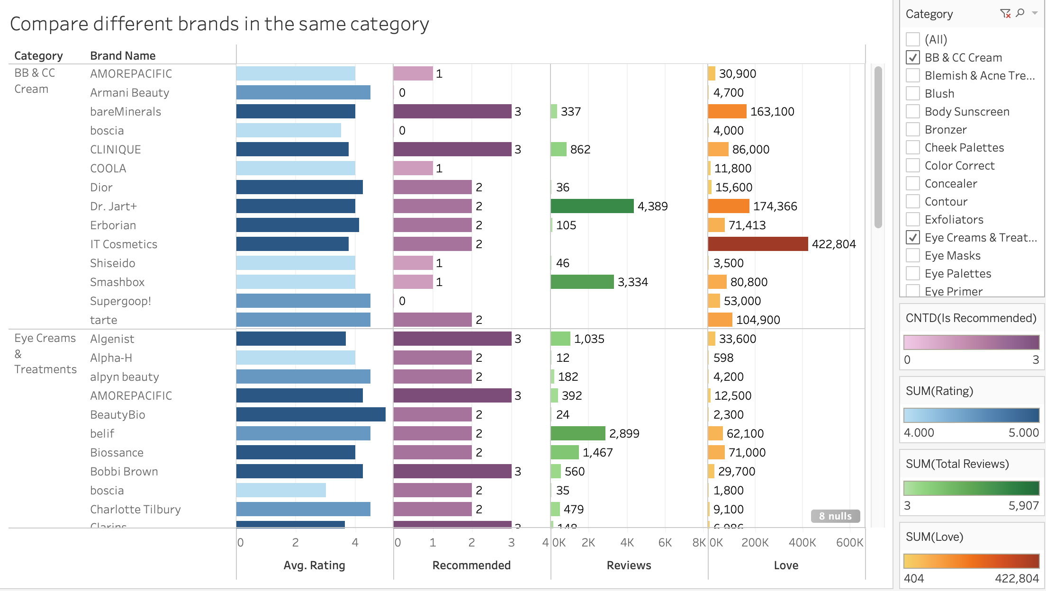
Case 2: Key Performance
Brand Level
This graph shows the comparison of different brands in the same category
Included metrics are average ratings, number of recommended， review, and love.
The darker the color of the bar, the larger the number

Slide 27
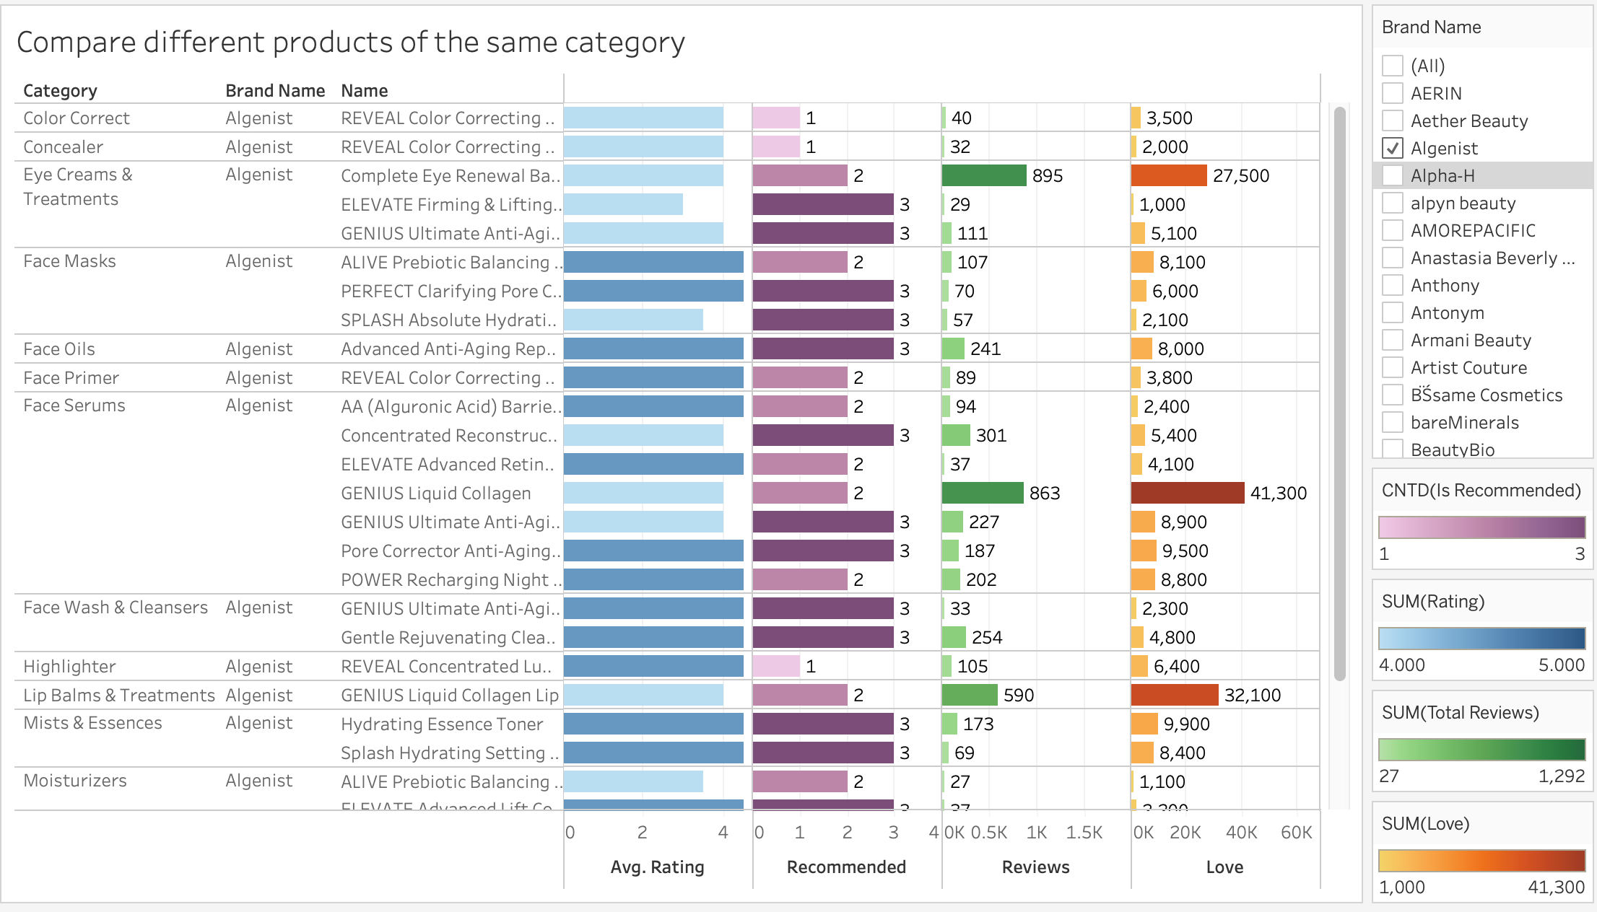
Case 2: Key Performance
Product Level
This graph shows the comparison of different products of the same brand through average ratings, number of recommended， reviews, and love.
The darker the color of the bar, the larger the number associated with it

Slide 28
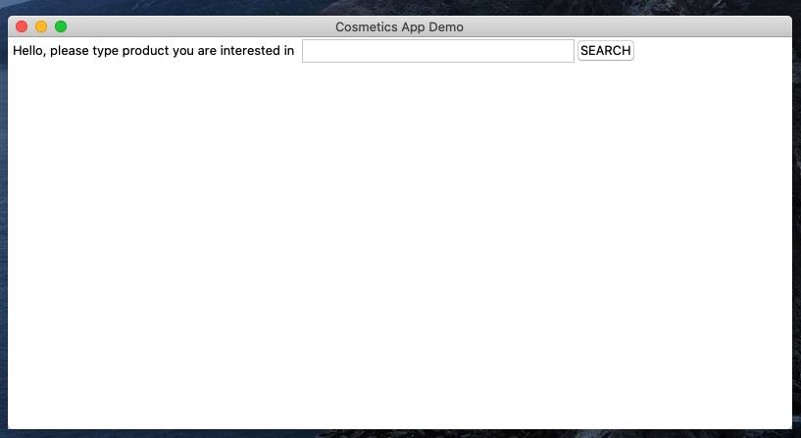
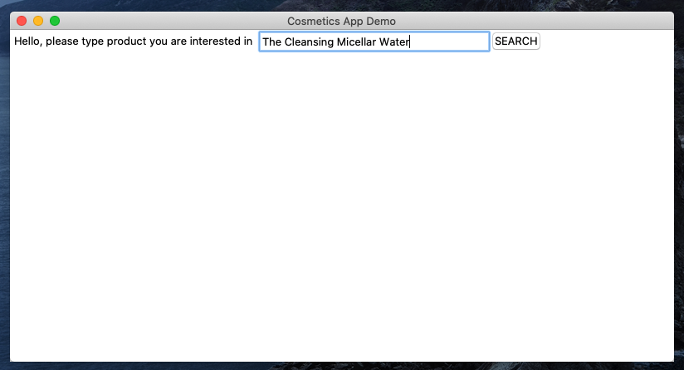
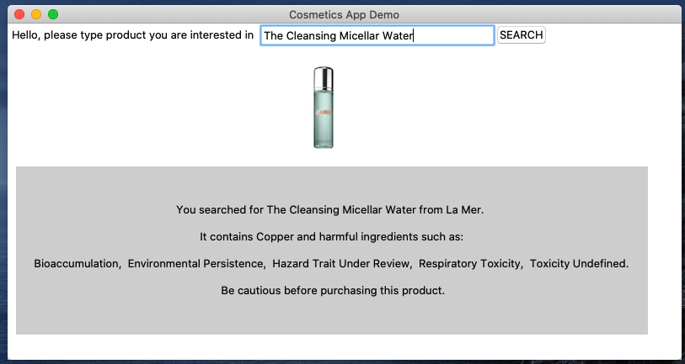
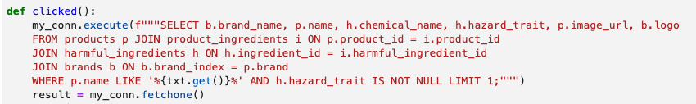
Case 3: User Journey On Demo App Built On Tkinter (Python GUI)
1
User opens the application
2
User searches for the interested product
3
Search query result is displayed with brand logo and product photo
Shows the product's ingredients and whether it contains harmful ingredients with a kind warning.​
Users can get comprehensive information on interested products’ ingredients and whether it contains any harmful substance
Business Case
Convert users to purchasing products by becoming go-to place for searching cosmetics products
Affiliate revenue is sizable with growing user base

Slide 29
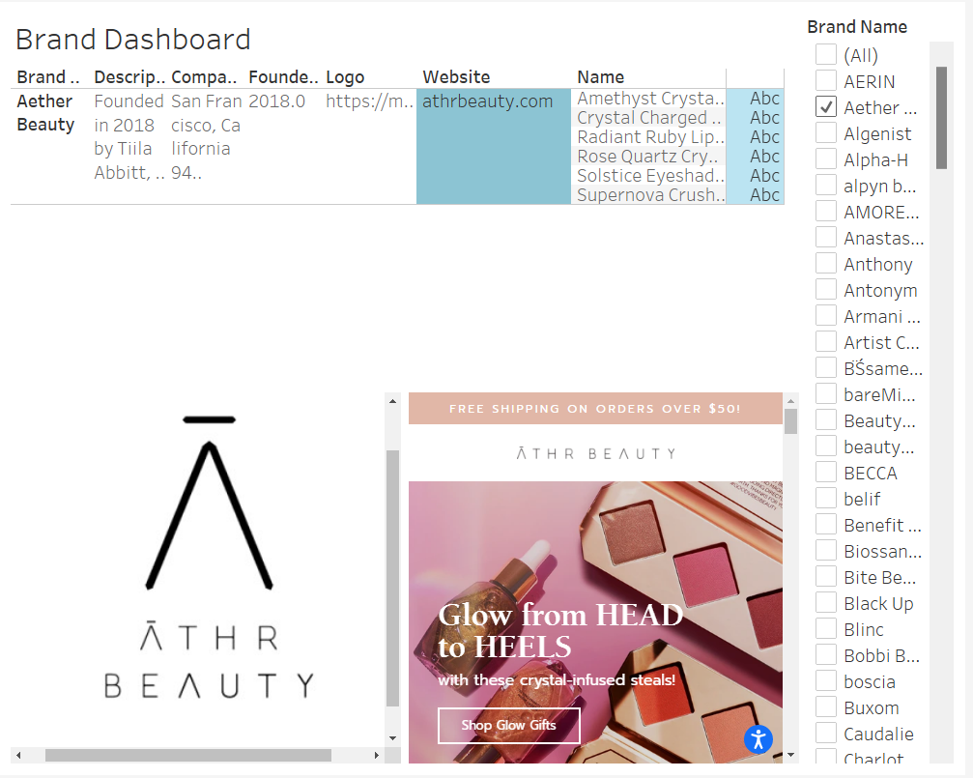
Case 4: Competitor Lookup
Clients can get a comprehensive overview of competitor brands
Used Tableau to create a Brand Dashboard
Dashboard uses brand name as a filter so that the user can choose which brand to look into
Dashboard contains information like brand description and their products
Dashboard also shows the brand logo and its official website if present

Slide 30
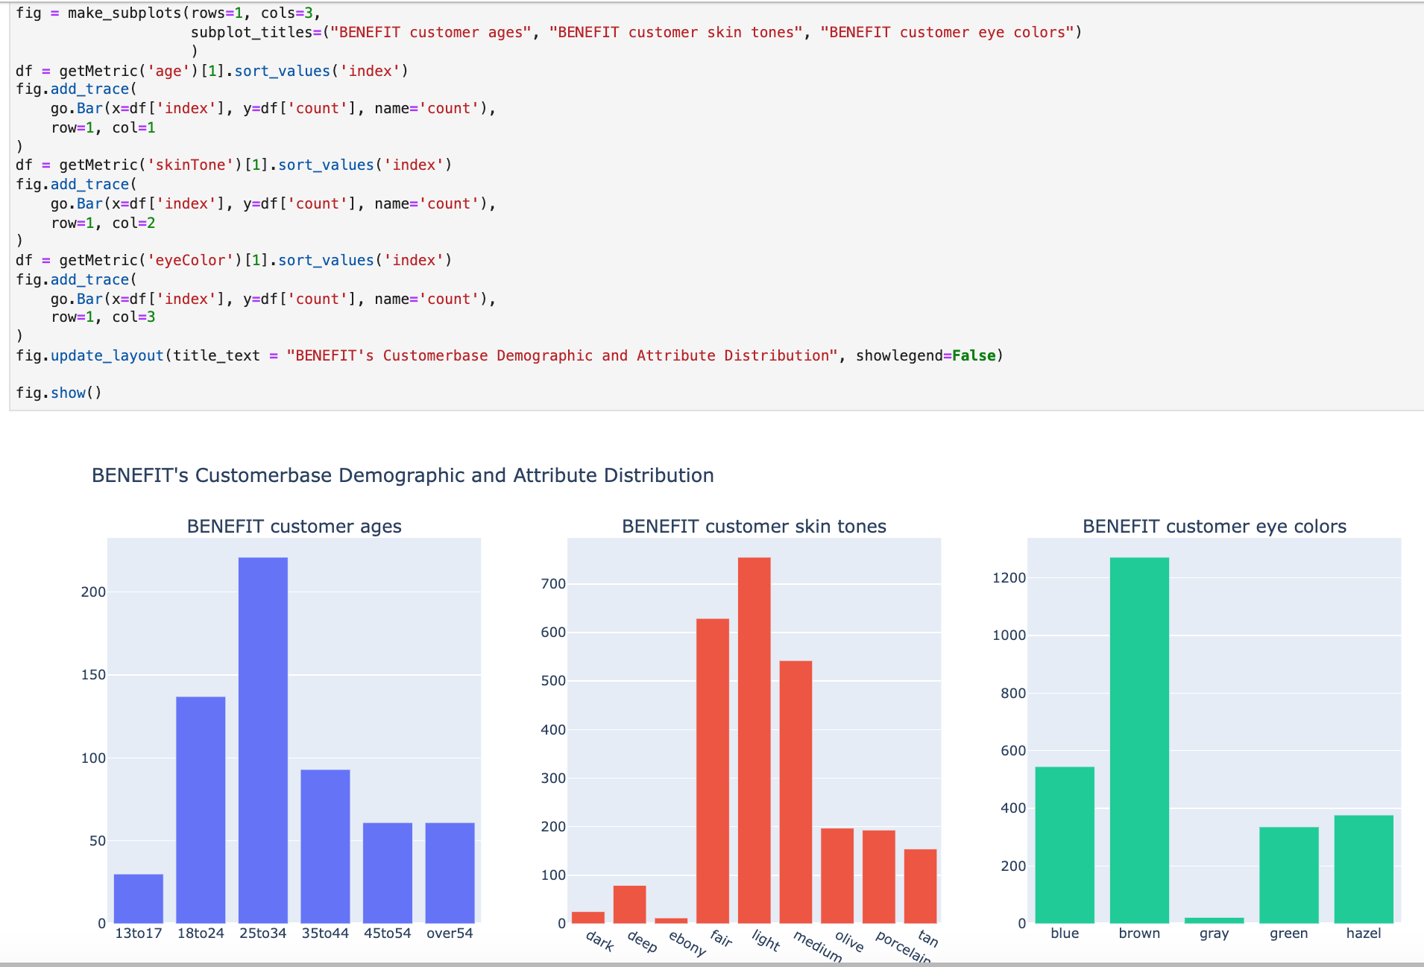

Case 5: Customer Demographic and Attribute Distribution
Clients can understand
customers based on user review analysis
The brand's main audience are between 18 to 34, although there are also customers from other age bands
Most customers are lighter skinned
Eye color distribution show that they have an area of improvement where they can release products that may match better with gray eyes

Slide 31
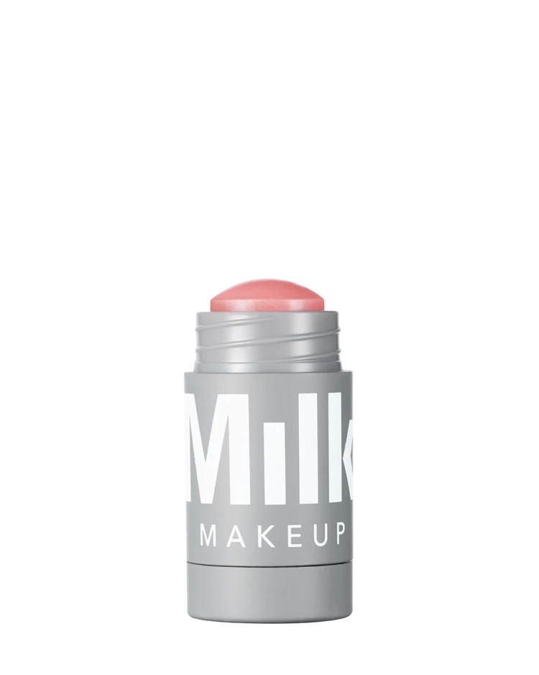
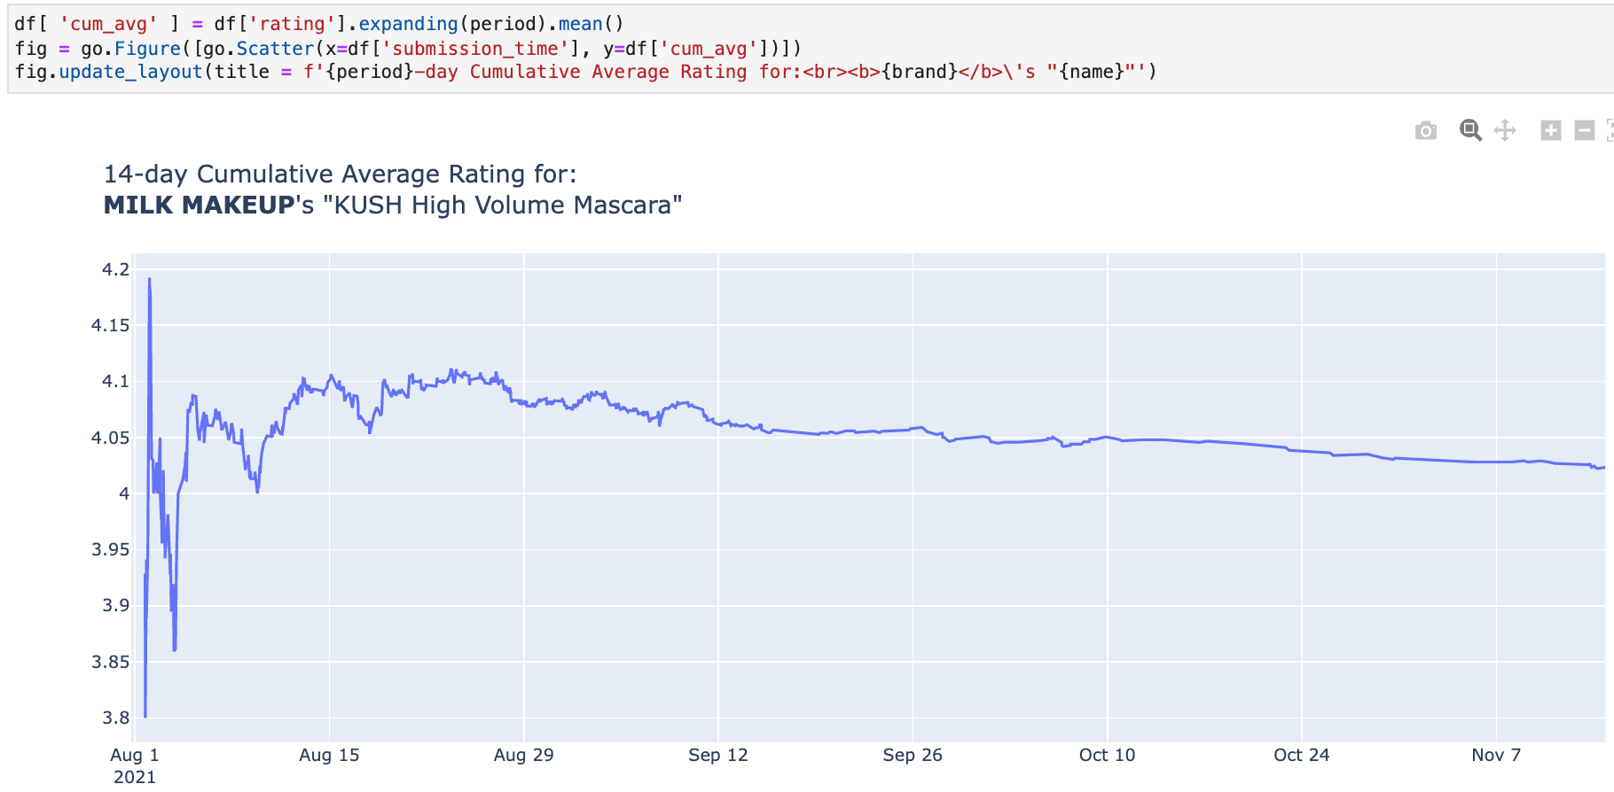
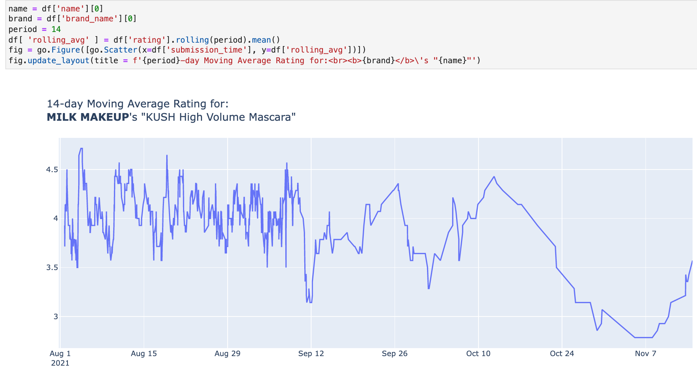
Case 5: Average Product Rating Over Time
Some products might be seasonal
Product review started off strong, but tapers off with slower frequency of review and dropping average rating value
Might suggest that product is not as good as expected or longer-term issues with the product that wasn't immediately apparent (e.g., weather incompatibility)

Slide 32
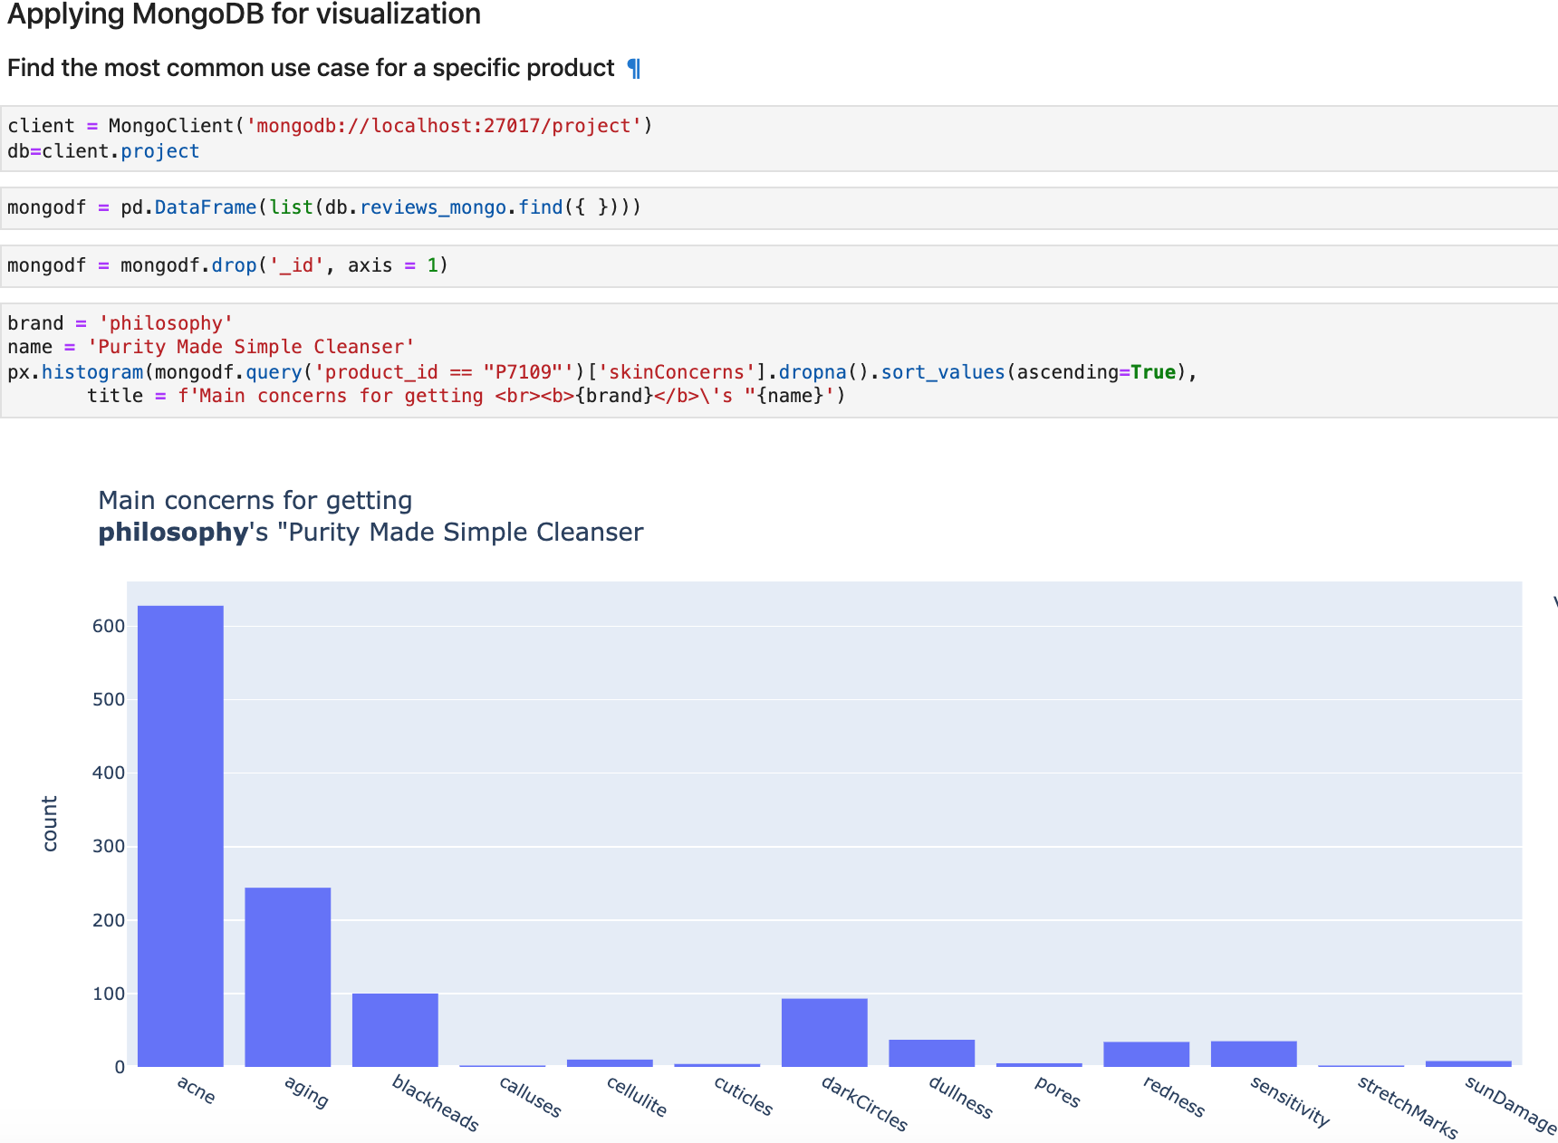


Case 5: Product for Specific Area of Concern
Review data can tell clients where users
find the product most useful
“Purity Made Simple Cleanser” was made for acne problems in mind
May also help with aging skin
Not a good fit for customers who are looking to fix stretch marks or sun damage
Brands can know consumers’ pain points and use insights to target marketing and improve formula to strengthen the product positioning
Consumer can make better informed decision about their intended purchasing before paying

Slide 33

Case 5: Top Products with Certain Attributes In Mind
Review data can tell clients all time favourites based on users’ attributes
For undecided customers, they can first look up for items that are often used by others who share similar attributes
For example, they may have a "combination" skin type, light skin tone, and blue eye color
This insight can help them choose the right product in a specific category (e.g., foundation)
Graph shows each product's "love" rating (a measure of how many times customers "love" a product), and their numeric rating

Slide 34
Lessons Learned & Recommendations
Lessons Learned | Recommendations
Larger datasets require paid API calls so data costs should be considered more carefully in data planning process Research API restrictions in data collection is essential as expectation and reality may differ (ie. Tweepy api gives only recent tweets) Heavy web scraping needs ways to bypass access restrictions (ie. Proper header and referrer required to access Sephora website) JavaScript is not rendered with only Python requests Data clean-up is indispensable, yet requires the most amount of time investment after data collection Using a balance of MySQL and NoSQL based on data types improves data handling and ease of producing analyses Expectations on data completeness should be based on data availability and must be managed early on GCP allows for synchronized working environment for team | Data Scope: Solidifying which metrics to prioritize for data collection and defining the data size should be done during initial data modelling Data Parity: Data availability of product review data and brands’ tweets varied per product and brand Unused Data: Analysis was limited to harmful ingredients, but good ingredients could have been used for new insights (ie. Pair the effect of ingredients and product reviews’ user concerns) Tweet location data was cleaned but unused; analysis around where negative sentiments on brands prevail could help brands target their marketing efforts Overall, more research on industry context could have helped improve data modelling process

Slide 35
Thank you

Slide 36
References
< Data Sources >
Sephora Products: https://www.kaggle.com/raghadalharbi/all-products-available-on-sephora-website
Harmful Ingredients: https://data.world/chhs/596b5eed-31de-4fd8-a645-249f3f9b19c4
Tweets: https://twitter.com/
Product Reviews: https://www.sephora.com/
Brands Information: https://www.linkedin.com
< Tools Used >
TextBlob: https://textblob.readthedocs.io/en/dev/
TKinter: https://docs.python.org/3/library/tkinter.html
BazaarVoice API: https://developer.bazaarvoice.com/conversations-api/home
Phantum Buster: https://phantombuster.com/
Tweepy: https://www.tweepy.org/
Selenium: https://www.selenium.dev/
Plotly: https://plotly.com/
Nltk: https://www.nltk.org/
PPTSlideTemplates: Slidego, https://slidesgo.com/

